Slide 1
Convolutional Neural Network
Reference Link
https://www.youtube.com/watch?v=Jy9-aGMB_TE

Slide 2
MLP vs CNN
Multilayer Perceptron (MLP): used to apply in computer vision, now succeeded by Convolutional Neural Network (CNN).
Has the characteristic of fully connected layers, where each perceptron is connected with every other perceptron.
Disadvantage is that the number of total parameters can grow to very high (number of perceptron in layer 1 multiplied by # of p in layer 2 multiplied by # of p in layer 3…).
This is inefficient because there is redundancy in such high dimensions.
Another disadvantage is that it disregards spatial information. It takes flattened vectors as inputs. A light weight MLP (2–3 layers) can easily achieve high accuracy with MNIST dataset.
Convolutional Neural Network (CNN): the incumbent, current favorite of computer vision algorithms, winner of multiple Imagenet competitions.
Can account for local connectivity (each filter is panned around the entire image according to certain size and stride, allows the filter to find and match patterns no matter where the pattern is located in a given image).
It takes matrices as well as vectors as inputs. The layers are sparsely connected or partially connected rather than fully connected. Every node does not connect to every other node.

Slide 3
Image Perspective
Instead of the image, the computer sees an array of pixels.
For example, if image size is 300 x 300. In this case, the size of the array will be 300x300x3.
Where 300 is width, next 300 is height and 3 is RGB channel values.
The computer is assigned a value from 0 to 255 to each of these numbers.
Тhis value describes the intensity of the pixel at each point.
To solve this problem the computer looks for the characteristics of the base level.
In human understanding such characteristics are for example the trunk or large ears.
For the computer, these characteristics are boundaries or curvatures.
And then through the groups of convolutional layers the computer constructs more abstract concepts.

Slide 4
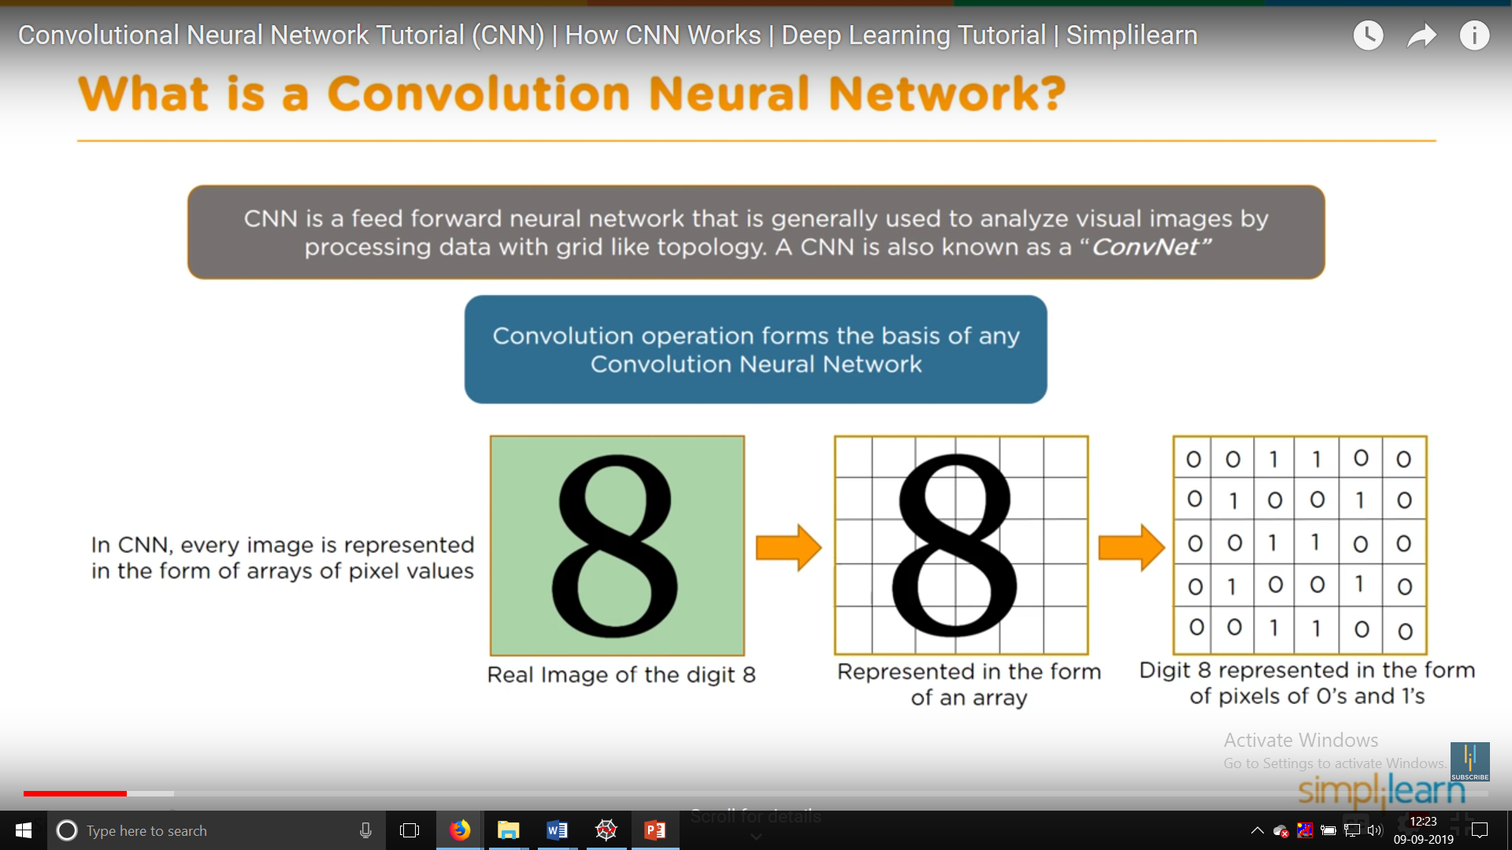

Slide 5
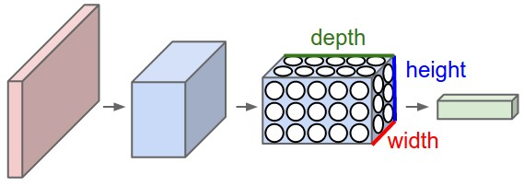
Arrangement of Neurons
A ConvNet arranges its neurons in three dimensions (width, height, depth), as visualized in one of the layers.
Every layer of a ConvNet transforms the 3D input volume to a 3D output volume of neuron activations.
In this example, the red input layer holds the image, so its width and height would be the dimensions of the image, and the depth would be 3 (Red, Green, Blue channels).
A ConvNet is made up of Layers. Every Layer has a simple API: It transforms an input 3D volume to an output 3D volume with some differentiable function that may or may not have parameters.

Slide 6
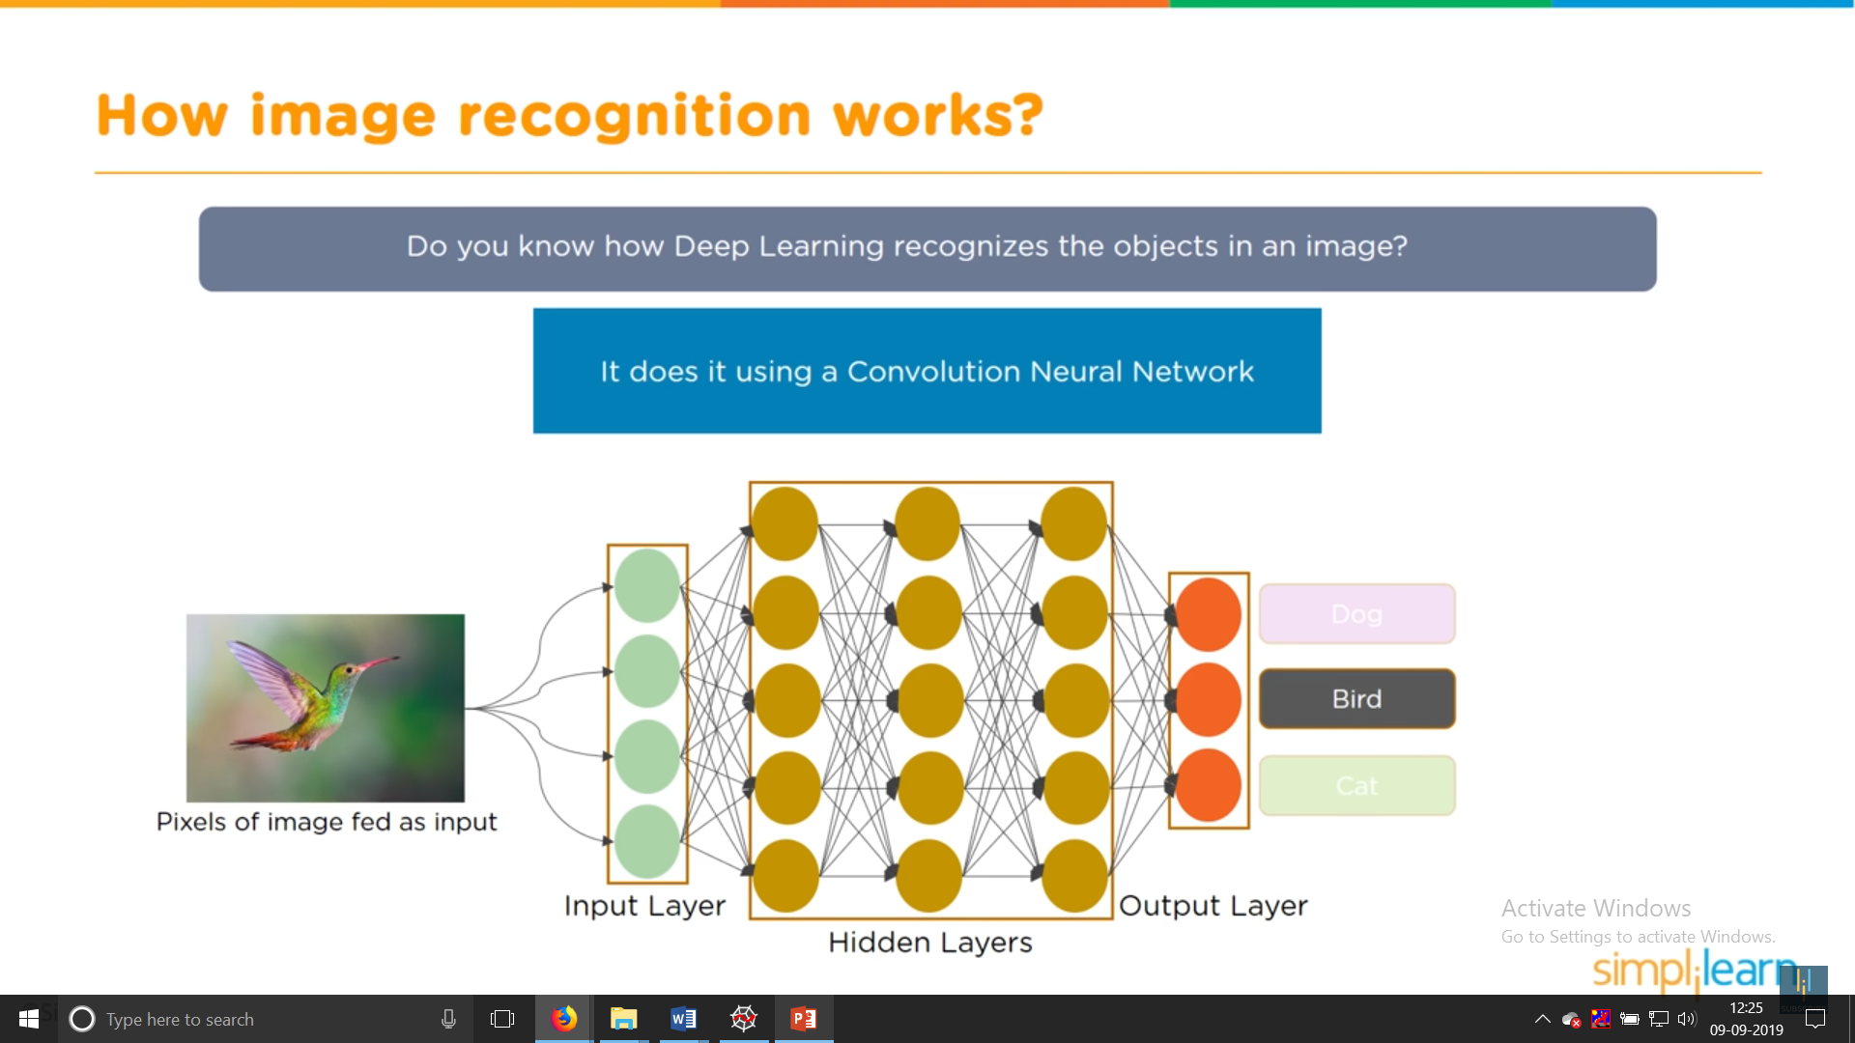

Slide 7
CNN Flow
Overview
We will go into more details below, but a simple ConvNet for CIFAR-10 classification could have the architecture [INPUT - CONV - RELU - POOL - FC].
In more detail:
INPUT [32x32x3] will hold the raw pixel values of the image, in this case an image of width 32, height 32, and with three color channels R,G,B.
CONV layer will compute the output of neurons that are connected to local regions in the input, each computing a dot product between their weights and a small region they are connected to in the input volume.
This may result in volume such as [32x32x12] if we decided to use 12 filters.
RELU layer will apply an elementwise activation function, such as the max(0,x) thresholding at zero. This leaves the size of the volume unchanged ([32x32x12]).
POOL layer will perform a downsampling operation along the spatial dimensions (width, height), resulting in volume such as [16x16x12].
FC (i.e. fully-connected) layer will compute the class scores, resulting in volume of size [1x1x10], where each of the 10 numbers correspond to a class score, such as among the 10 categories of CIFAR-10.
As with ordinary Neural Networks and as the name implies, each neuron in this layer will be connected to all the numbers in the previous volume

Slide 9
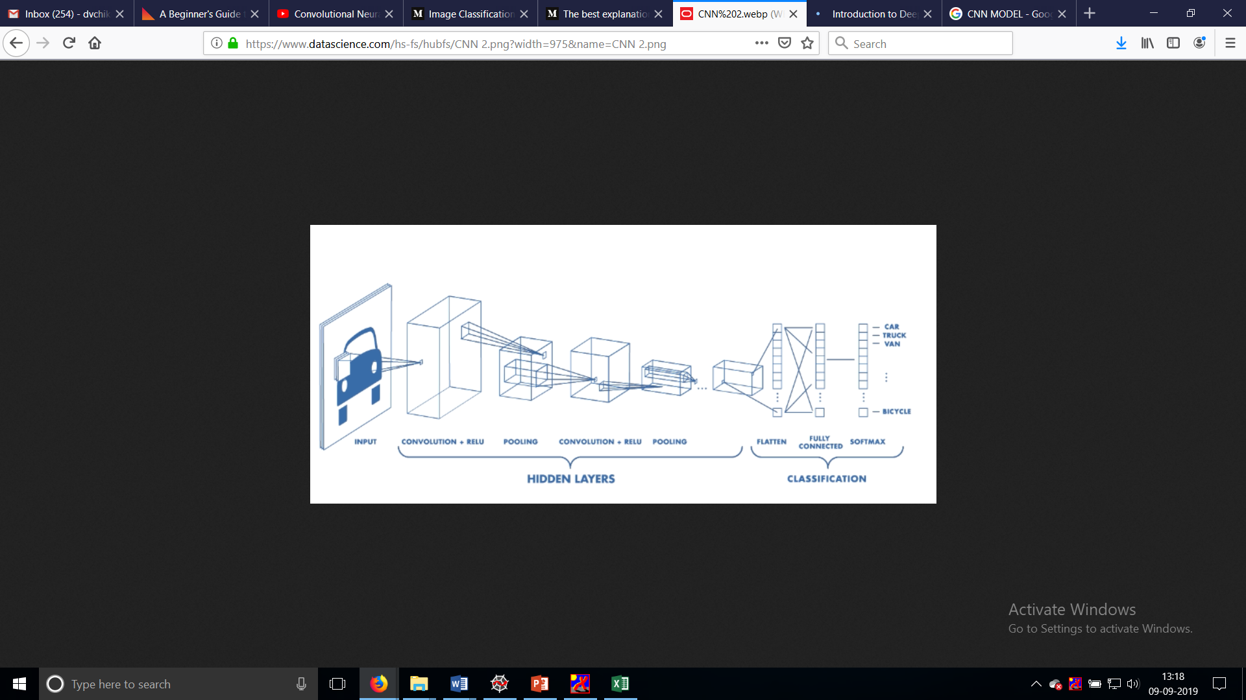

Slide 10
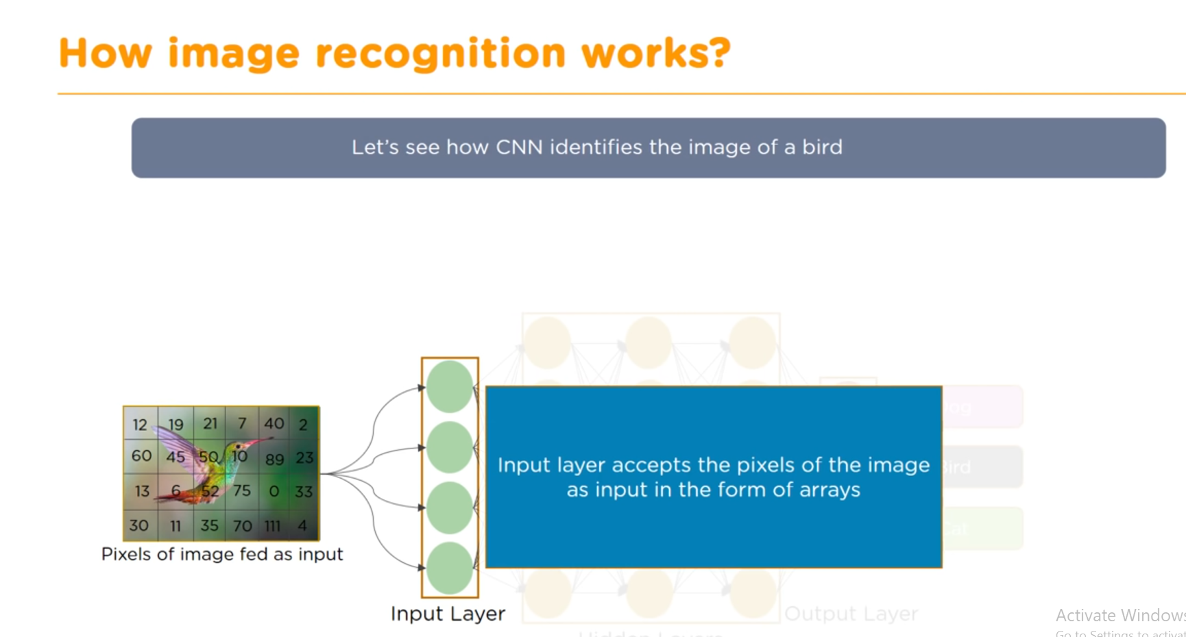

Slide 11
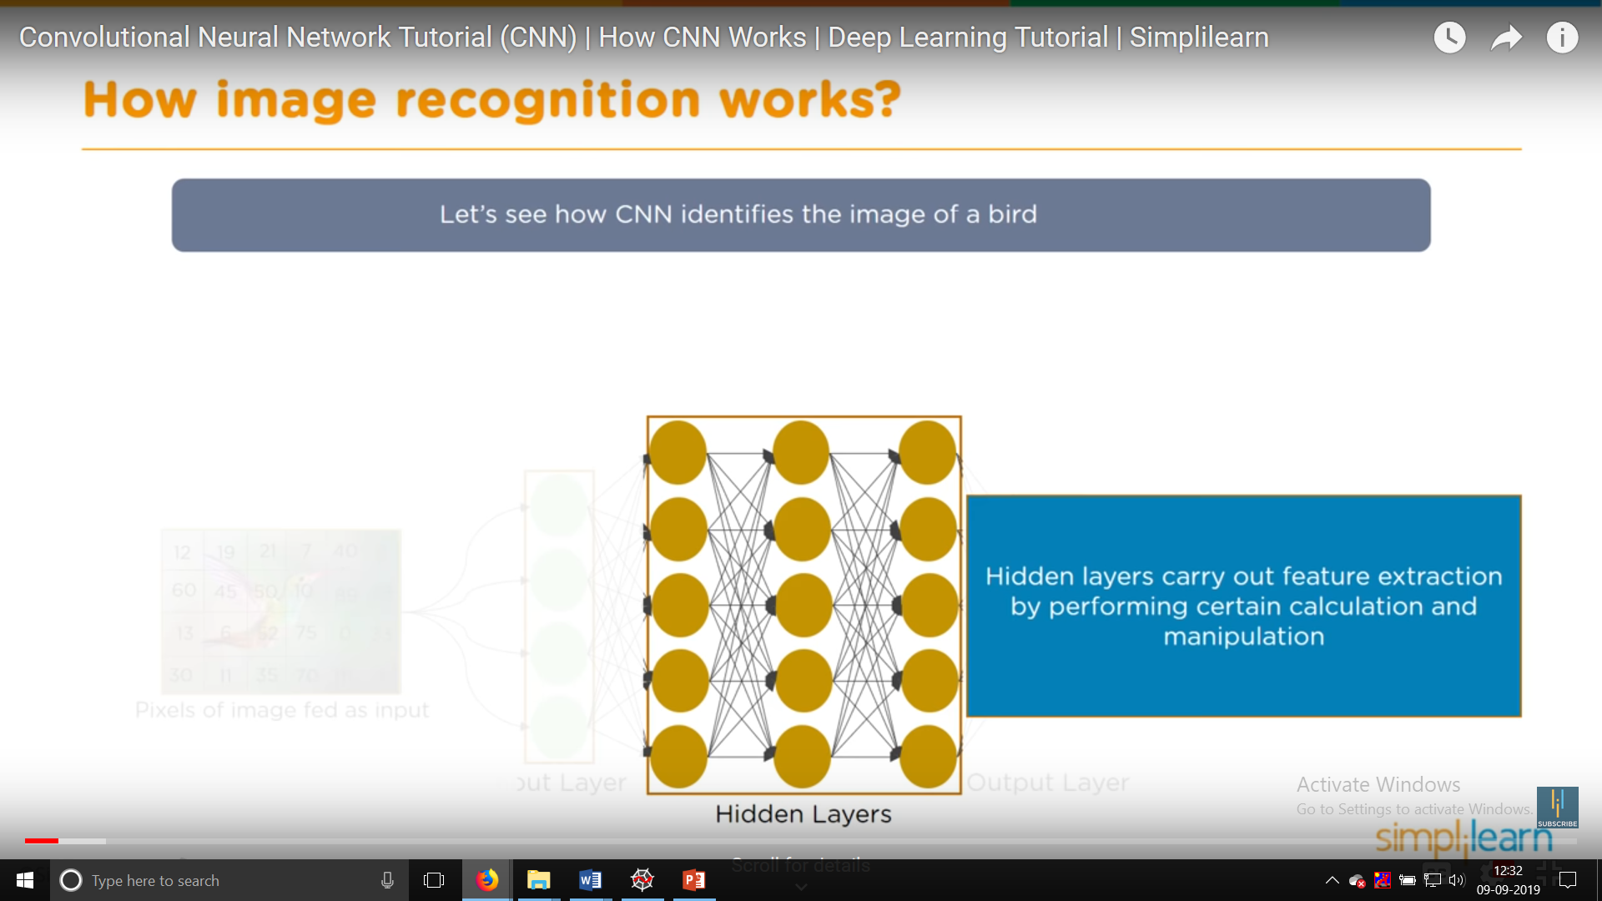

Slide 12
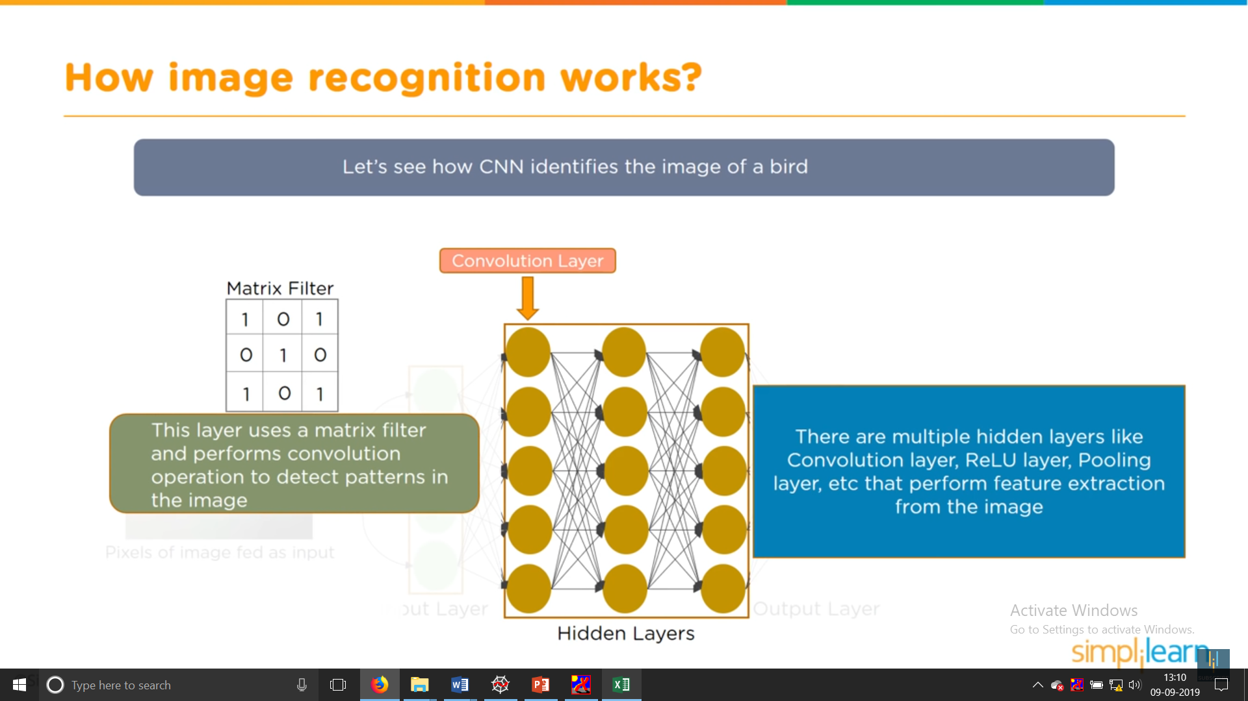

Slide 13
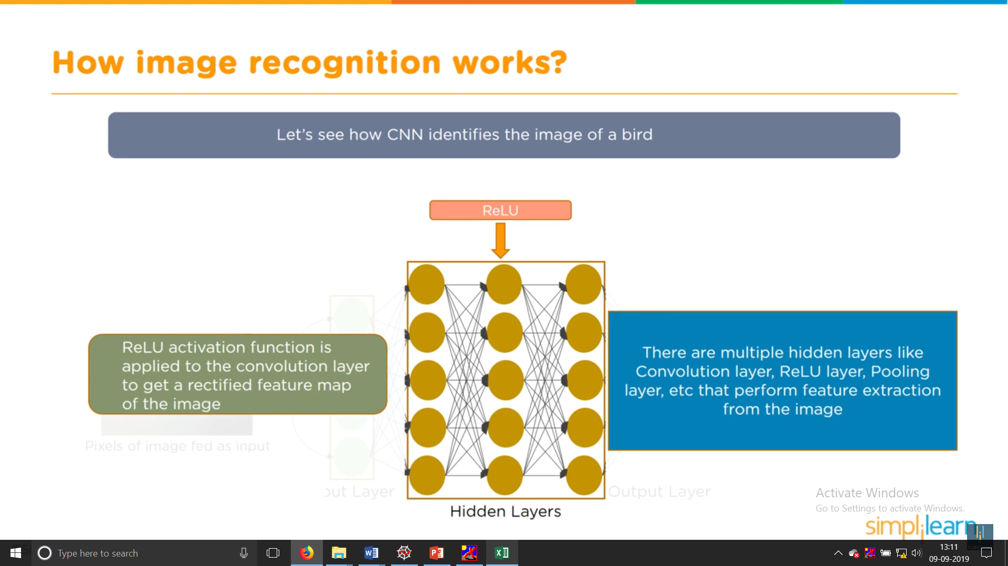

Slide 14
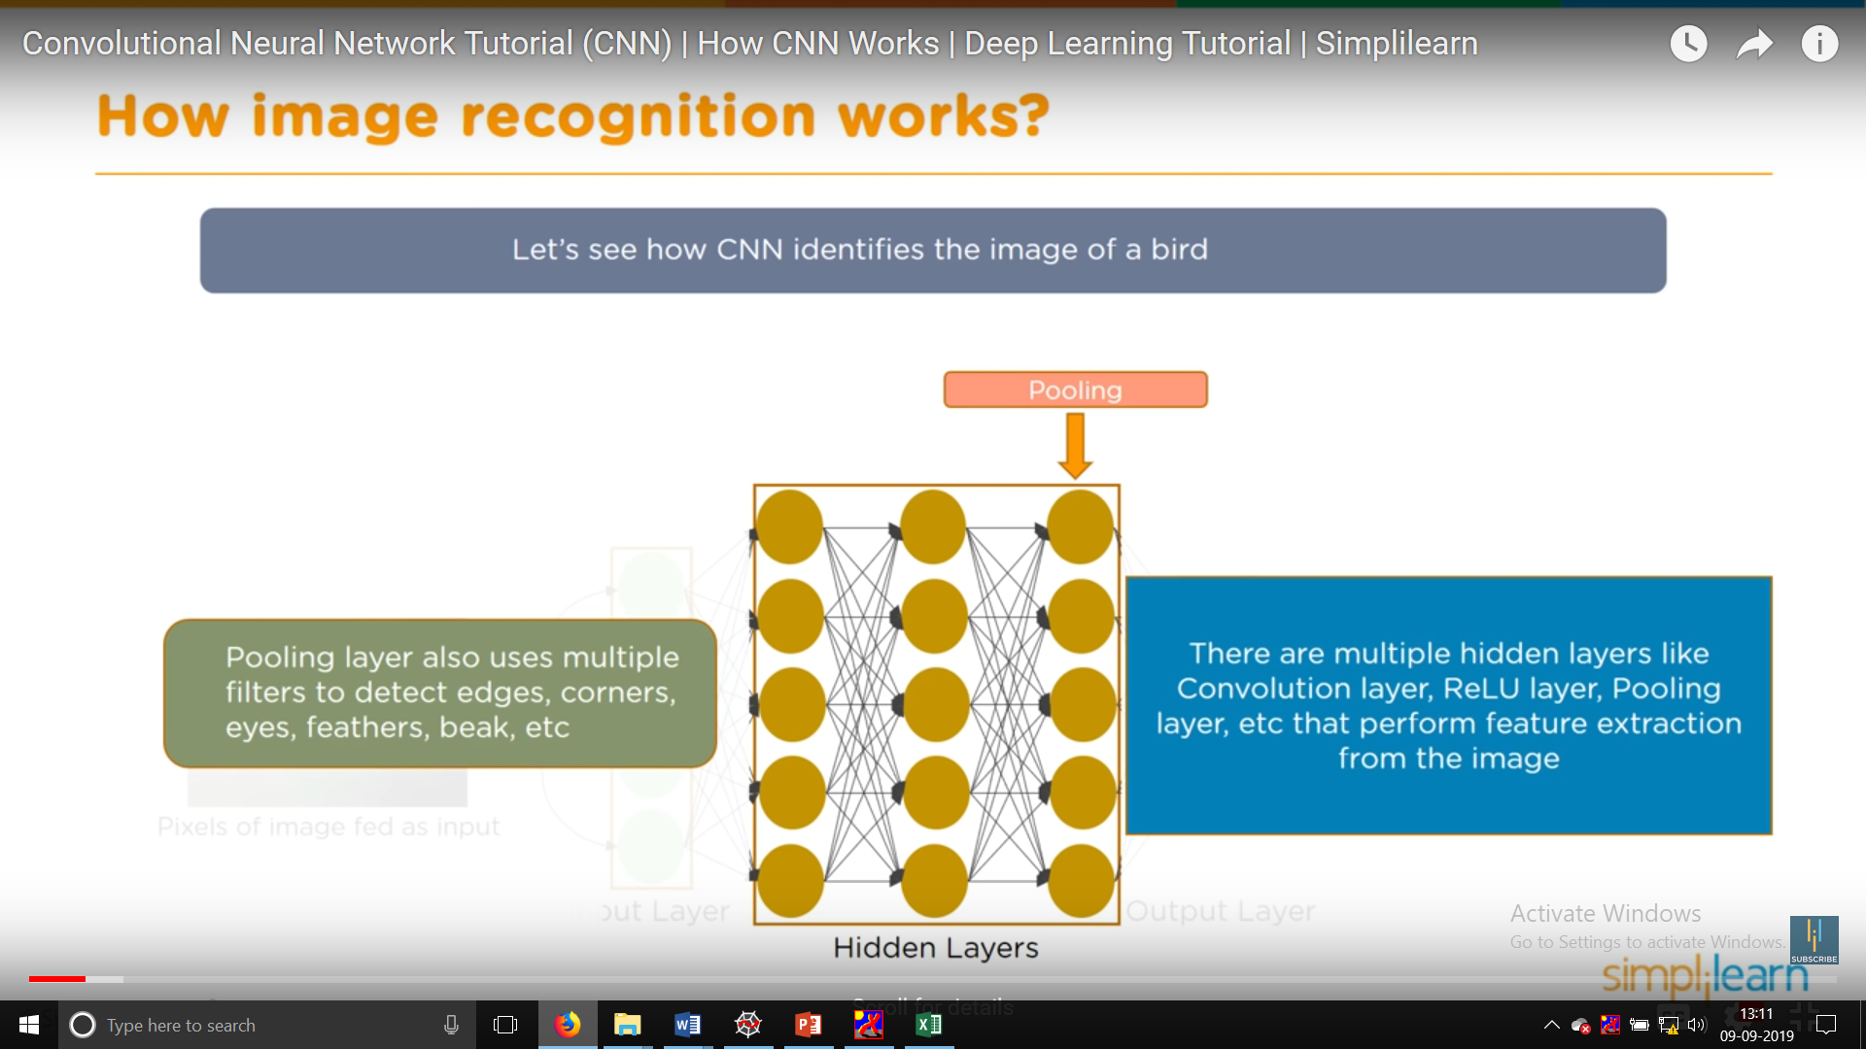

Slide 15
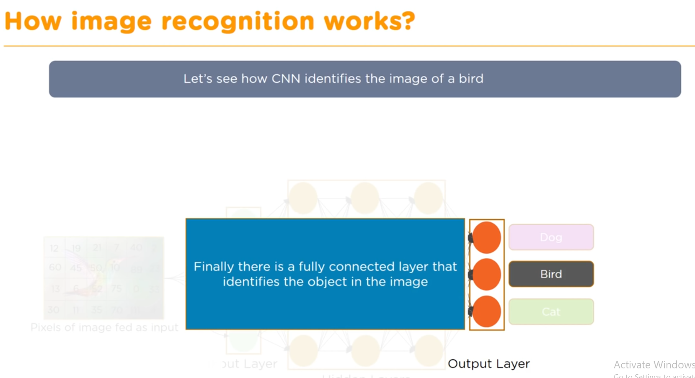

Slide 16
Input Image
In the figure, we have an RGB image which has been separated by its three color planes — Red, Green, and Blue. There are a number of such color spaces in which images exist — Grayscale, RGB, HSV, CMYK, etc.
You can imagine how computationally intensive things would get once the images reach dimensions, say 8K (7680×4320).
The role of the ConvNet is to reduce the images into a form which is easier to process, without losing features which are critical for getting a good prediction.
This is important when we are to design an architecture which is not only good at learning features but also is scalable to massive datasets.

Slide 17

Input Image

Slide 18
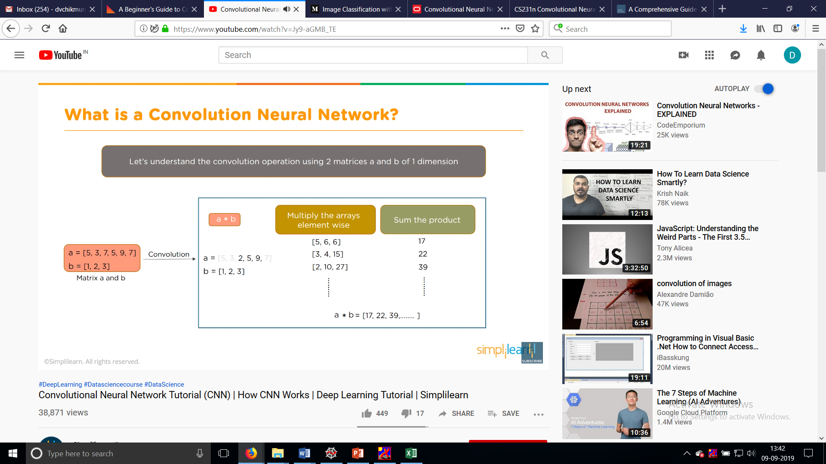
Convolution Operation

Slide 19
Convolutional Layer
The Convolution layer is always the first. Тhe image (matrix with pixel values) is entered into it.
Imagine that the reading of the input matrix begins at the top left of image.
Next the software selects a smaller matrix there, which is called a filter (or neuron, or core).
Then the filter produces convolution, i.e. moves along the input image.
The filter’s task is to multiply its values by the original pixel values.
All these multiplications are summed up.
One number is obtained in the end.
Since the filter has read the image only in the upper left corner, it moves further and further right by 1 unit performing a similar operation.
After passing the filter across all positions, a matrix is obtained, but smaller then a input matrix.

Slide 20
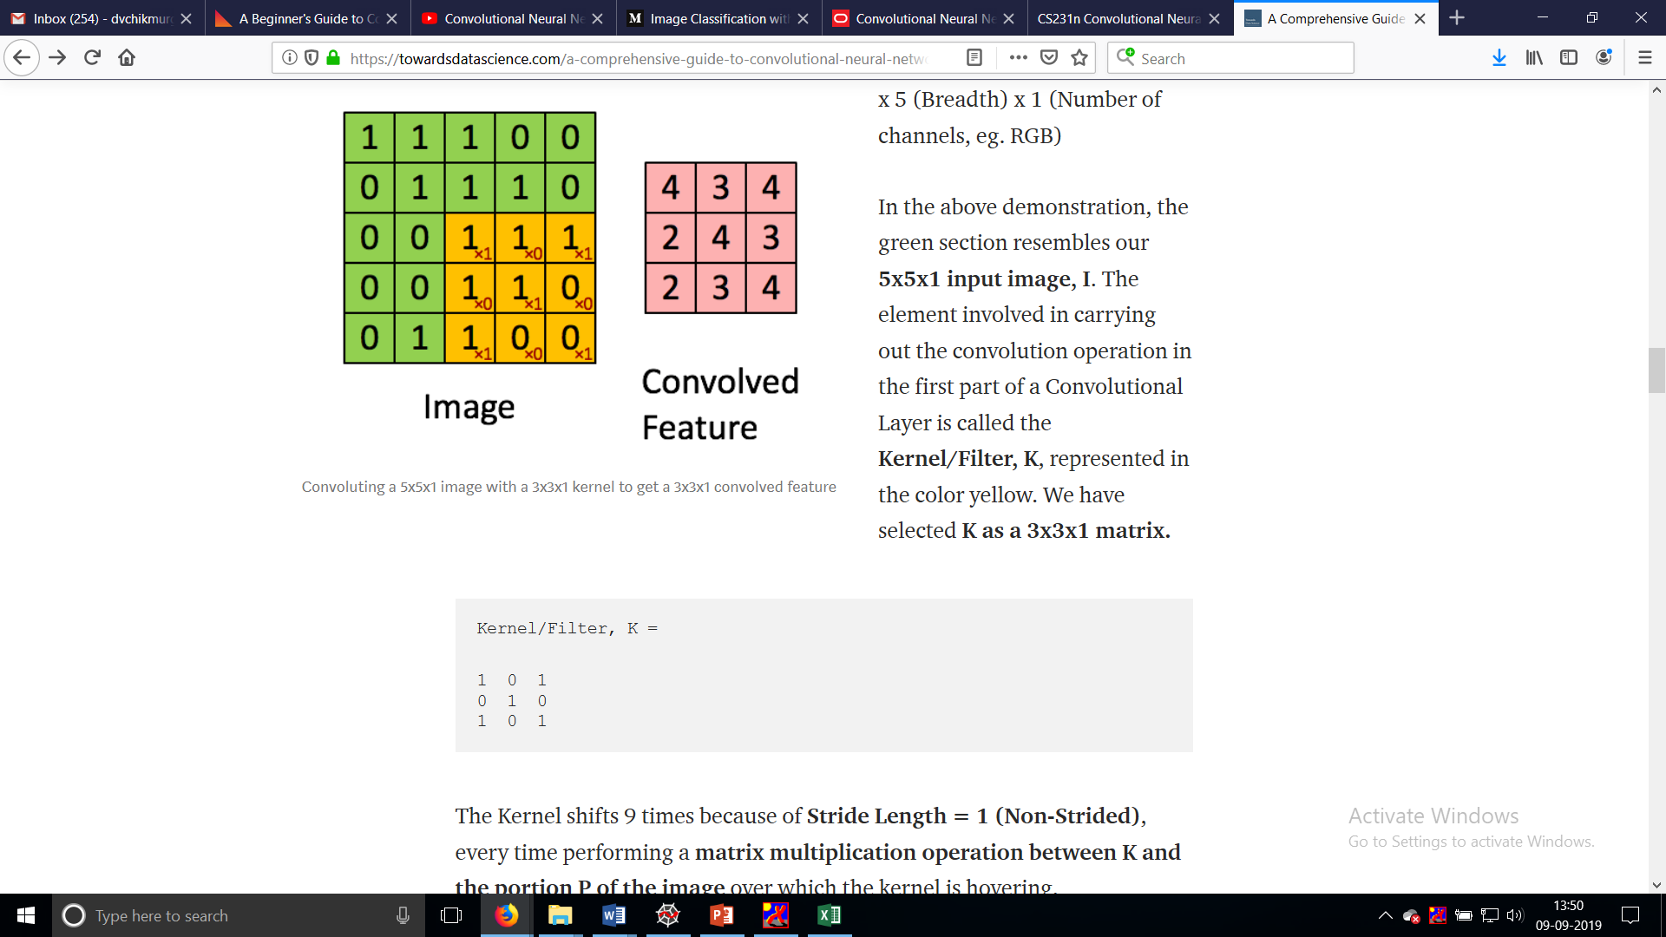
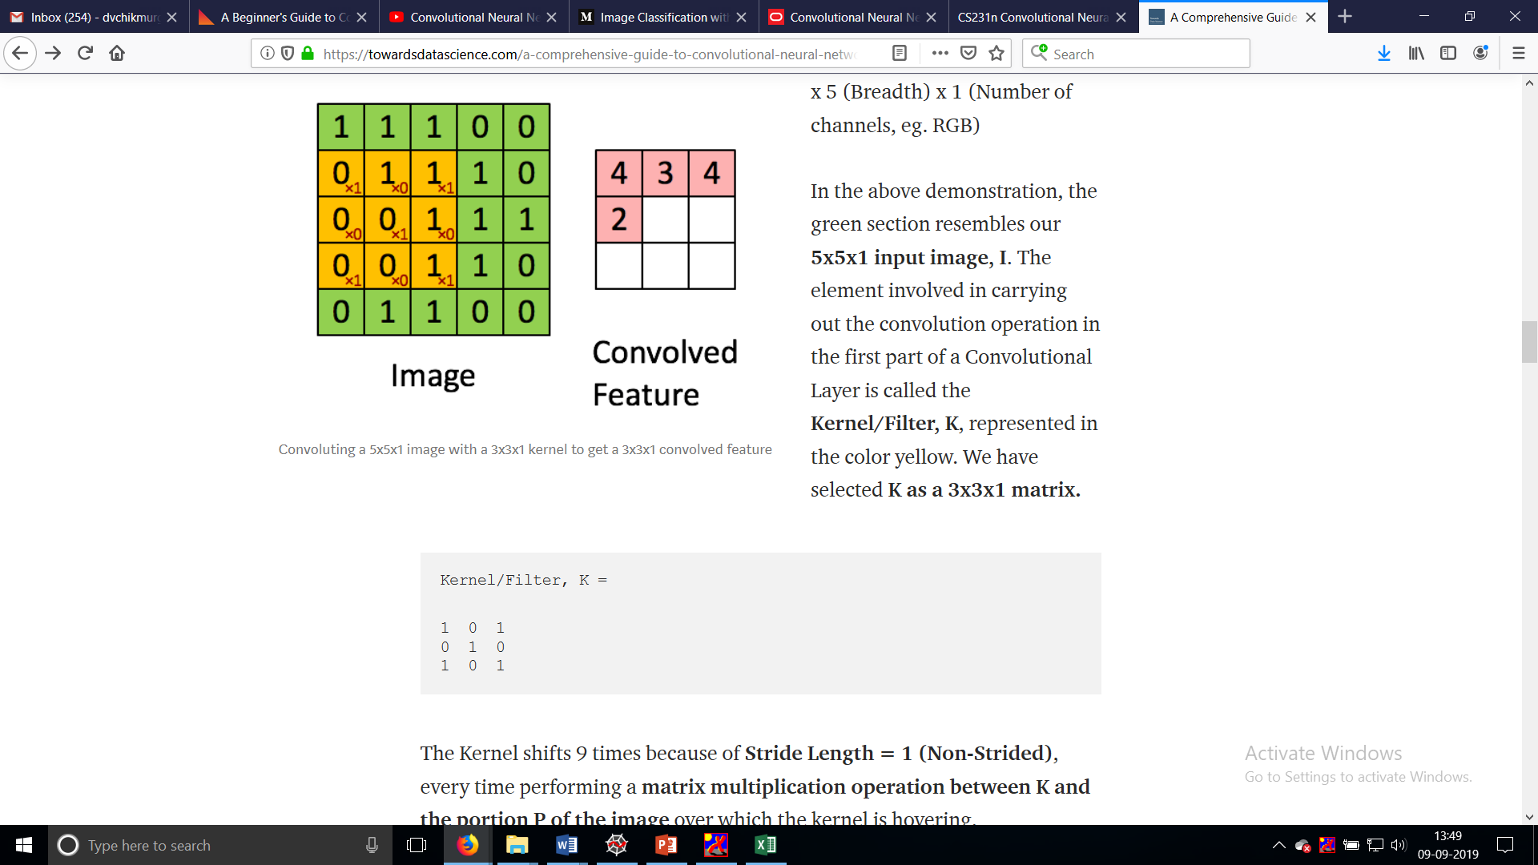
Convolution
Image Dimensions = 5 (Height) x 5 (Breadth) x 1 (Number of channels, eg. RGB)
In the above demonstration, the green section resembles our 5x5x1 input image, I.
The element involved in carrying out the convolution operation in the first part of a Convolutional Layer is called the Kernel/Filter, K, represented in the color yellow. We have selected K as a 3x3x1 matrix.
Convoluting a 5x5x1 image with a 3x3x1 kernel to get a 3x3x1 convolved feature

Slide 21

Convolution
The Kernel shifts 9 times because of Stride Length = 1 (Non-Strided), every time performing a matrix multiplication operation between K and the portion P of the image over which the kernel is hovering.
The filter moves to the right with a certain Stride Value till it parses the complete width.
Moving on, it hops down to the beginning (left) of the image with the same Stride Value and repeats the process until the entire image is traversed.
Movement of the Kernel

Slide 22
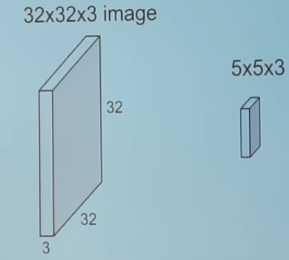
Convolve
let us first understand what convolution means.

Slide 23
Convolution
In the case of images with multiple channels (e.g. RGB), the Kernel has the same depth as that of the input image.
Matrix Multiplication is performed between Kn and In stack ([K1, I1]; [K2, I2]; [K3, I3]) and all the results are summed with the bias to give us a squashed one-depth channel Convoluted Feature Output.

Slide 24

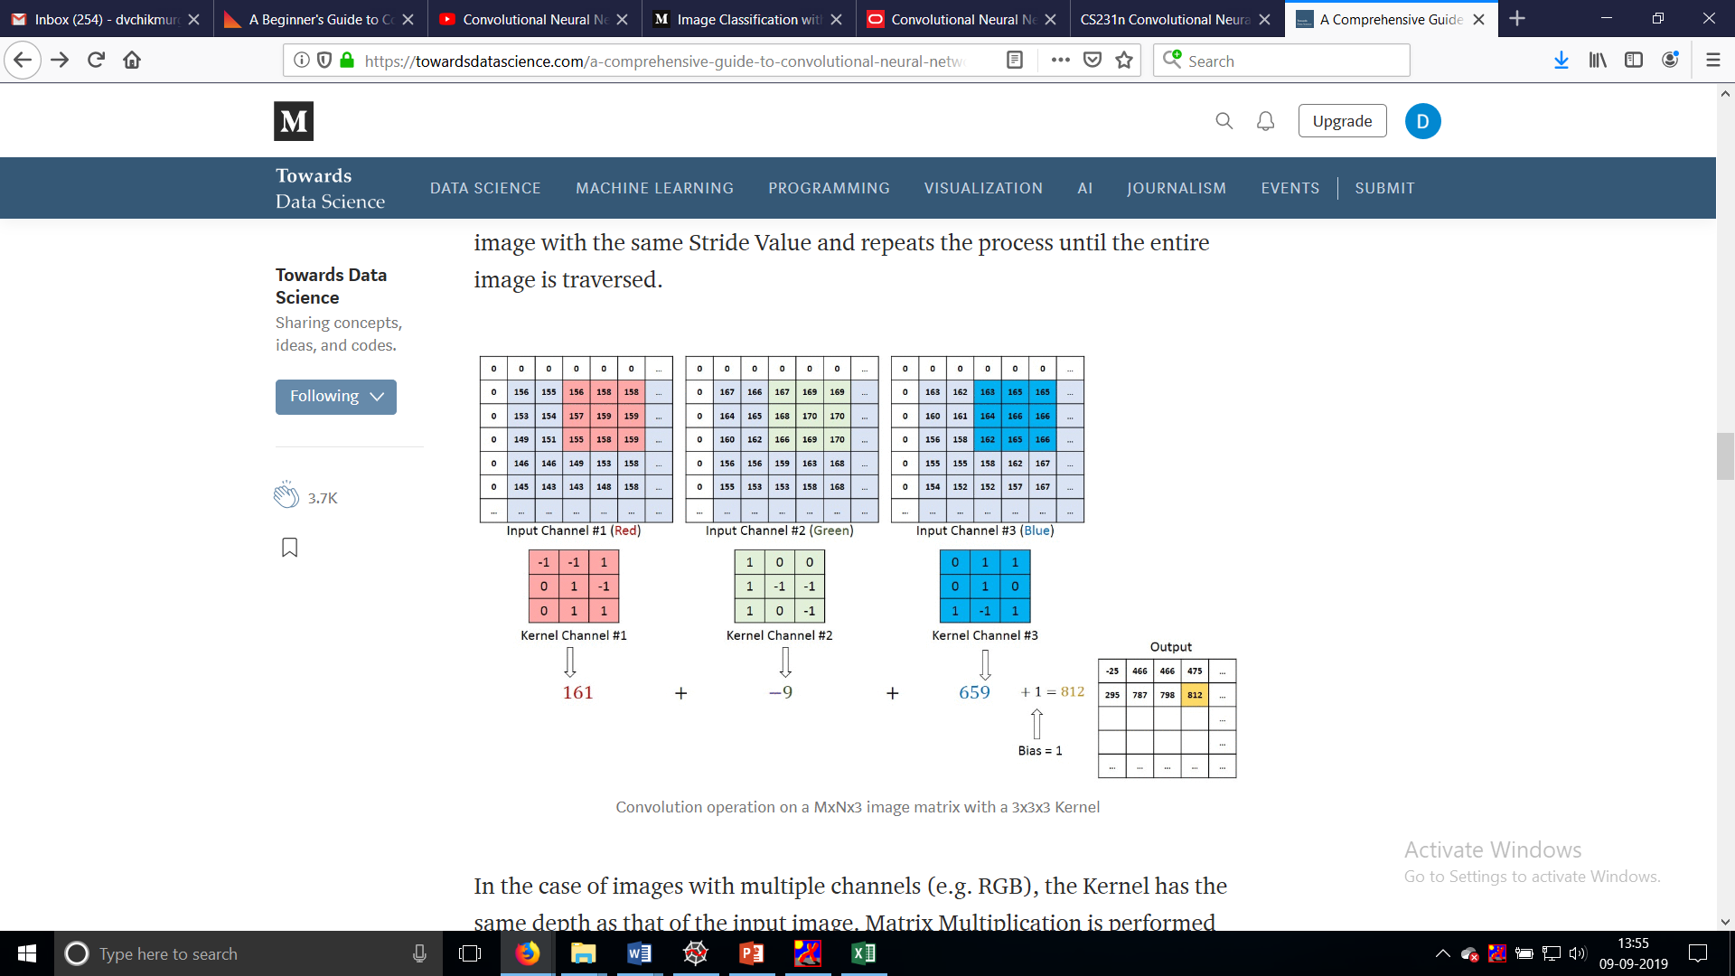

Slide 25
The objective of the Convolution Operation is to extract the high-level features such as edges, from the input image.
ConvNets need not be limited to only one Convolutional Layer.
Conventionally, the first ConvLayer is responsible for capturing the Low-Level features such as edges, color, gradient orientation, etc.
With added layers, the architecture adapts to the High-Level features as well, giving us a network which has the wholesome understanding of images in the dataset, similar to how we would.

Slide 26
Stride
Stride is the number of pixels with which we slide our filter, horizontally or vertically.
In other words, in that case we moved our filter one pixel at each step to calculate the next convoluion output.
However, for a convolution with stride 2, we calculate the output for every other pixel (or jump 2 pixels) and as a contrary the output of the convolution would be roughly half the size of the input image.
Figure compares two 2D convolutions with strides one and two, respectively.

Slide 27

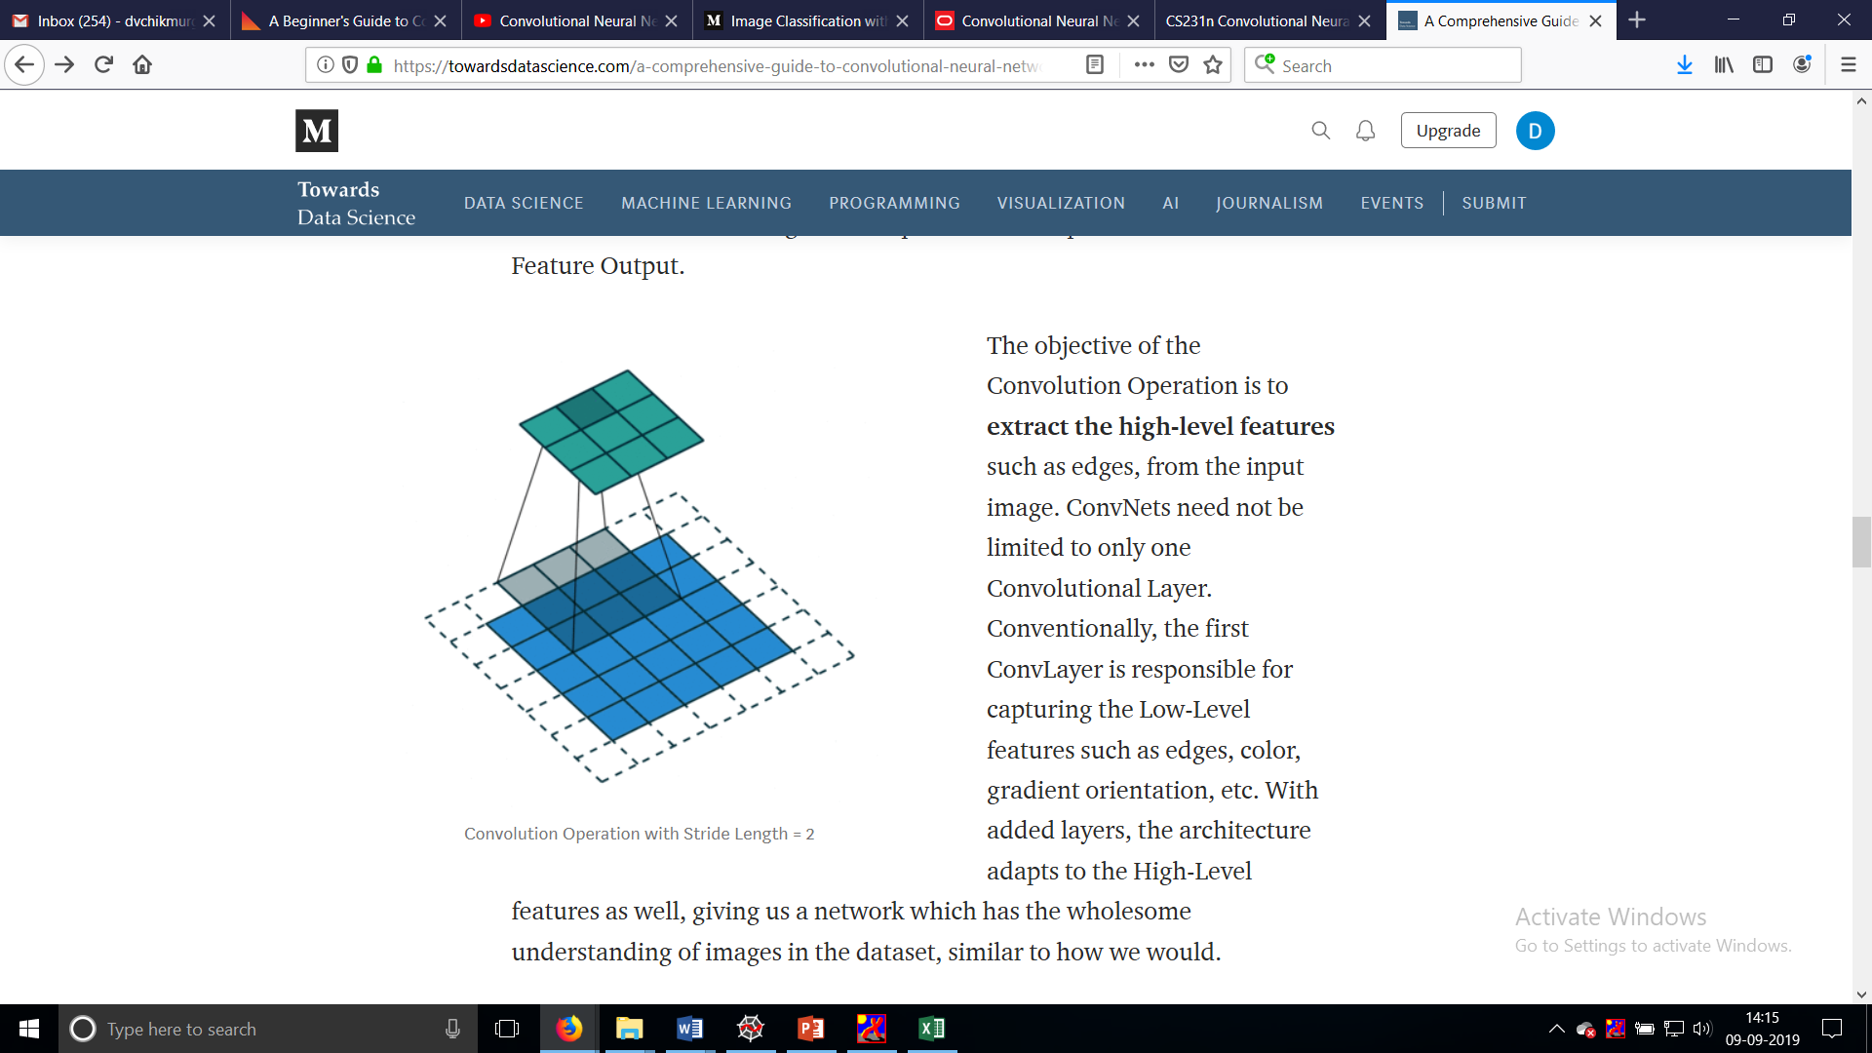
Stride

Slide 28
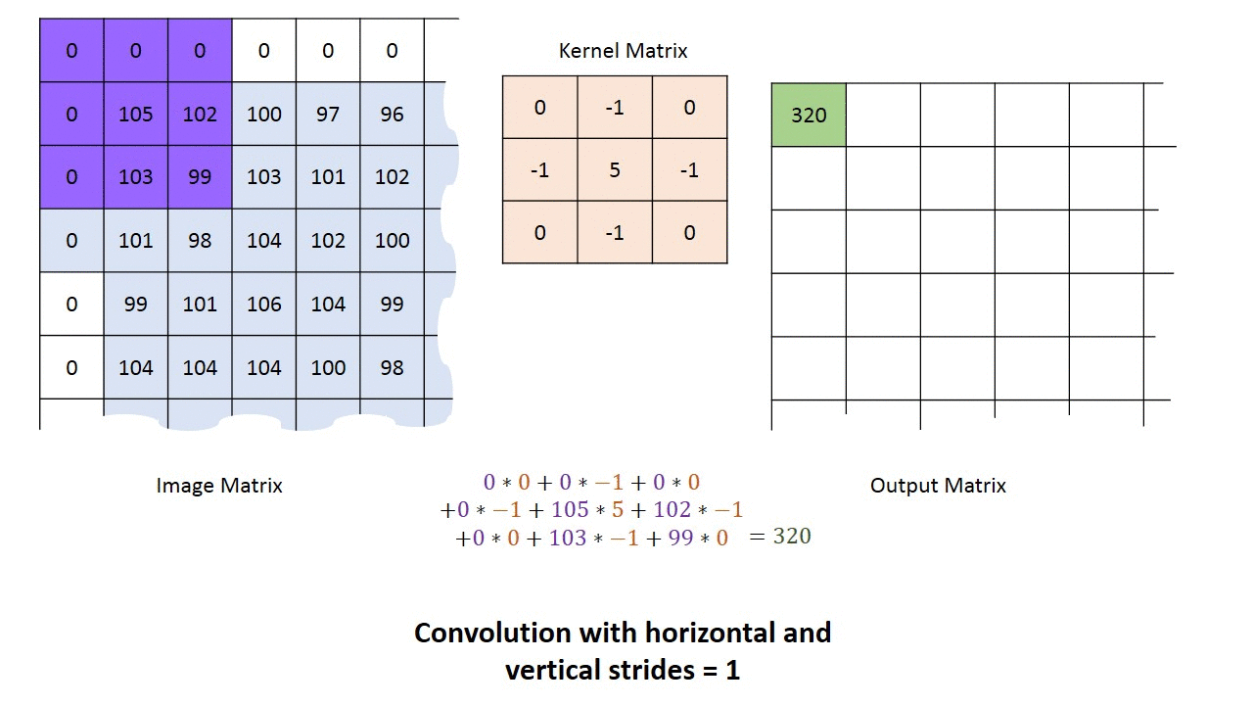
Stride

Slide 29
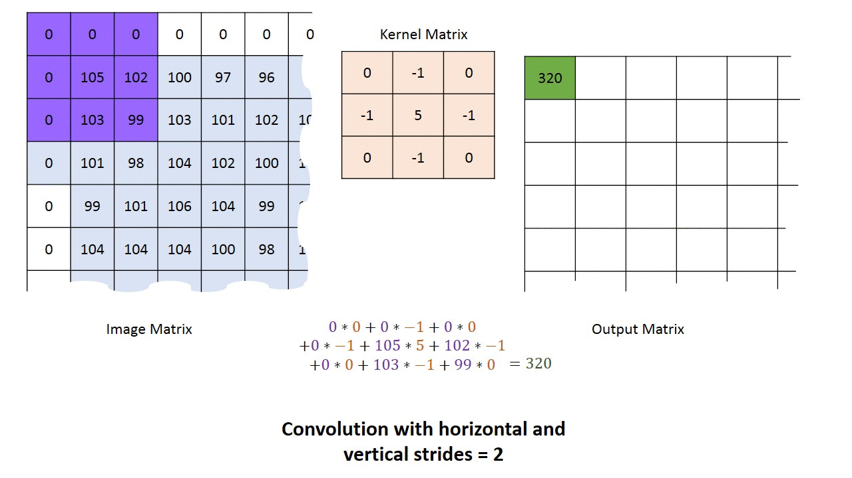
Stride

Slide 30
Padding
So if you take this gray scale image.
The pixel in the corner will only get covers one time but if you take the middle pixel it will get covered more than once basically what does that means is we have more info on that middle pixel so these are the two main downsides
Shrinking outputs
Loosing information on corners of the image
To overcome this we can introduce Padding to an image. So what is padding
It’s an additional layer that we can add to the border of an image.
For an example see the figure below there one more layer added to the 4*4 image and now it has converted in to 5*5 image

Slide 31
Zero-Padding
Zero-padding refers to the process of symmetrically adding zeroes to the input matrix.
It’s a commonly used modification that allows the size of the input to be adjusted to our requirement.
It is mostly used in designing the CNN layers when the dimensions of the input volume need to be preserved in the output volume.
In general, setting zero padding to be P=(F−1)/2

Slide 32
Padding
There are two types of results to the operation — one in which the convolved feature is reduced in dimensionality as compared to the input, and the other in which the dimensionality is either increased or remains the same.
This is done by applying Valid Padding in case of the former, or Same Padding in the case of the latter.
When we augment the 5x5x1 image into a 6x6x1 image and then apply the 3x3x1 kernel over it, we find that the convolved matrix turns out to be of dimensions 5x5x1. Hence the name — Same Padding.
On the other hand, if we perform the same operation without padding, we are presented with a matrix which has dimensions of the Kernel (3x3x1) itself — Valid Padding.

Slide 33

Same Padding
SAME padding: 5x5x1 image is padded with 0s to create a 6x6x1 image

Slide 34
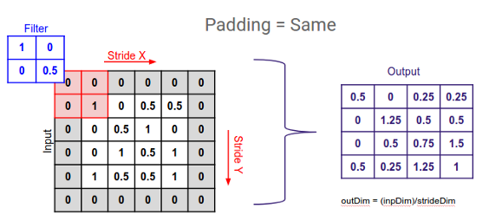
So now there is more frame that covers the edge pixels of an image cool.
More info more accuracy that’s how neural net works so we have more info now we can get more accuracy done

Slide 35
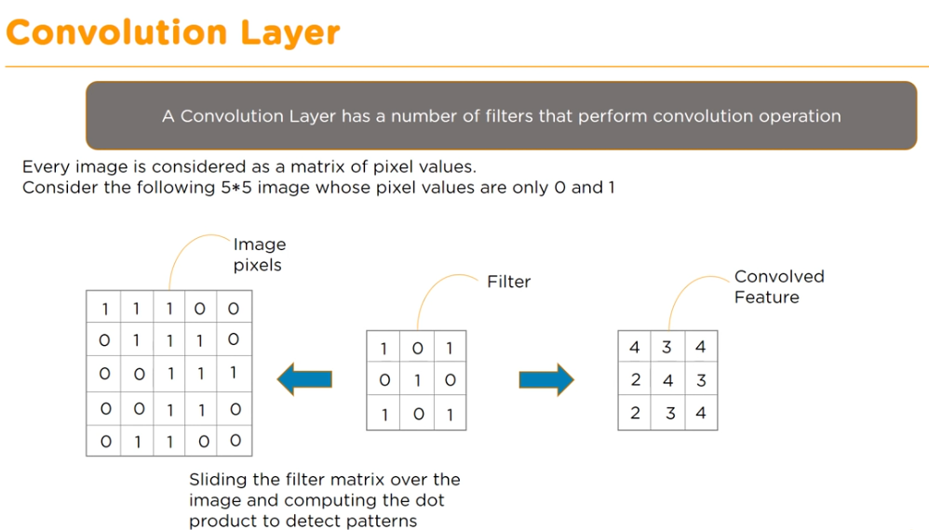

Slide 36
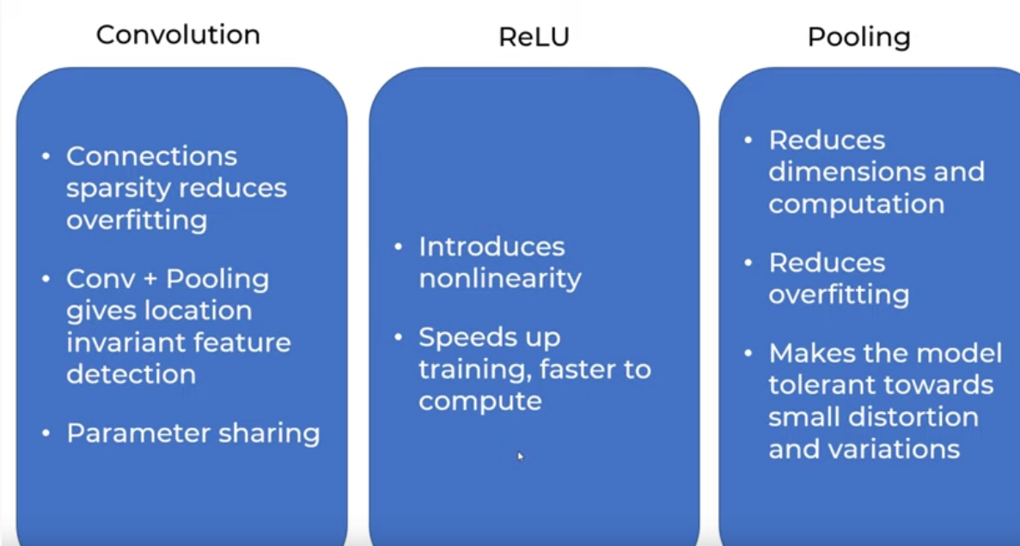

Slide 37
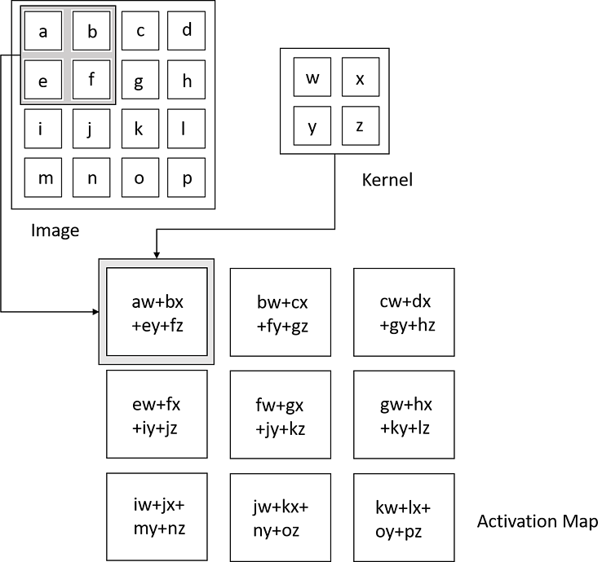
Convolutional Layer
Convolution Operation (Source: Deep Learning by Ian Goodfellow, Yoshua Bengio, and Aaron Courville)

Slide 38
Convolutional Layer
The first layer in CNN is Convolutional Layer
It apply a filter to an input to create a feature map that summarizes the presence of detected feature in the input.

Slide 39
Spatial arrangement-Hyper Parameter
We have explained the connectivity of each neuron in the Conv Layer to the input volume, but we haven’t yet discussed how many neurons there are in the output volume or how they are arranged.
Three hyperparameters control the size of the output volume: the depth, stride and zero-padding.
First, the depth of the output volume is a hyperparameter: it corresponds to the number of filters we would like to use, each learning to look for something different in the input.
For example, if the first Convolutional Layer takes as input the raw image, then different neurons along the depth dimension may activate in presence of various oriented edges, or blobs of color.
Second, we must specify the stride with which we slide the filter. When the stride is 1 then we move the filters one pixel at a time.
When the stride is 2 (or uncommonly 3 or more, though this is rare in practice) then the filters jump 2 pixels at a time as we slide them around. This will produce smaller output volumes spatially.
As we will soon see, sometimes it will be convenient to pad the input volume with zeros around the border.
Third, The size of this zero-padding is a hyperparameter.
The nice feature of zero padding is that it will allow us to control the spatial size of the output volumes (most commonly as we’ll see soon we will use it to exactly preserve the spatial size of the input volume so the input and output width and height are the same).

Slide 40
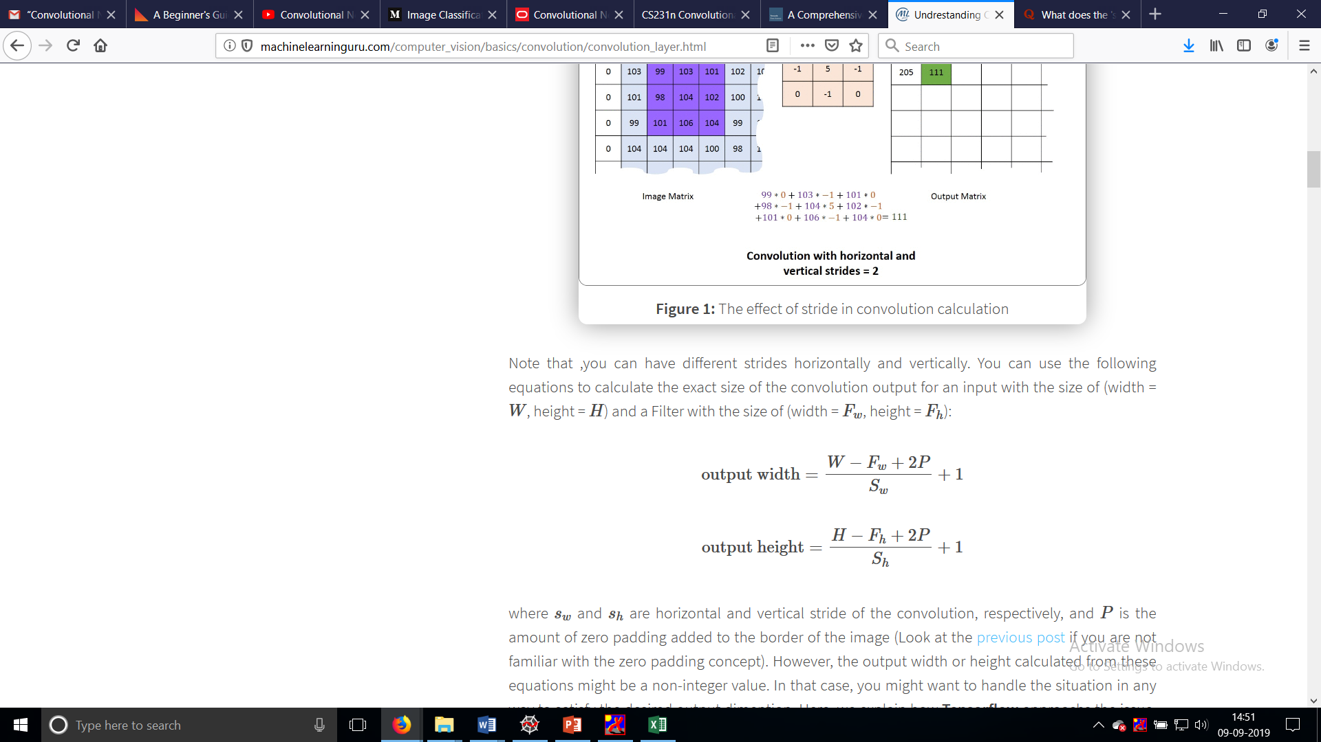
Hyper Parameter
Note that ,you can have different strides horizontally and vertically.
You can use the following equations to calculate the exact size of the convolution output for an input with the size of (width = W, height = H) and a Filter with the size of (width = Fw, height = Fh):
where sw and sh are horizontal and vertical stride of the convolution, respectively, and P is the amount of zero padding added to the border of the image.

Slide 41
Constraints on strides.
Note again that the spatial arrangement hyperparameters have mutual constraints.
For example, when the input has size W=10 , no zero-padding is used P=0, and the filter size is F=3, then it would be impossible to use stride S=2, since (W−F+2P)/S+1=(10−3+0)/2+1=4.5
i.e. not an integer, indicating that the neurons don’t “fit” neatly and symmetrically across the input.
Therefore, this setting of the hyperparameters is considered to be invalid, and a ConvNet library could throw an exception or zero pad the rest to make it fit, or crop the input to make it fit, or something.

Slide 42
Depth of CONV layer
Depth of CONV layer is number of filters it is using. Depth of a filter is equal to depth of image it is using as input.
For Example: Let's say you are using an image of 227*227*3. Now suppose you are using a filter of size of 11*11(spatial size).
This 11*11 square will be slided along whole image to produce a single 2 dimensional array as a response. But in order to do so, it must cover every aspect inside of 11*11 area.
Therefore depth of filter will be depth of image = 3. Now suppose we have 96 such filter each producing different response.
This will be depth of Convolutional layer. It is simply number of filters used.

Slide 43
Real-world example.
The Krizhevsky et al. architecture that won the ImageNet challenge in 2012 accepted images of size [227x227x3].
On the first Convolutional Layer, it used neurons with receptive field size F=11, stride S=4 and no zero padding P=0. Since (227 - 11)/4 + 1 = 55, and since the Conv layer had a depth of K=96, the Conv layer output volume had size [55x55x96].
Each of the 55*55*96 neurons in this volume was connected to a region of size [11x11x3] in the input volume.
Moreover, all 96 neurons in each depth column are connected to the same [11x11x3] region of the input, but of course with different weights.

Slide 44
Real-world example.
Let's say you have 10 filters where each filter is the size of 5x5x3. What does this mean? the depth of this layer is 10 which is equal to the number of filters.
Size of each filter can be defined as we want e.g., 5x5x3 in this case where 3 is the depth of the previous layer.

Slide 45
Feature or Activation Map
A feature map, or activation map, is the output activations for a given filter and the definition is the same regardless of what layer you are on.
Feature map and activation map mean exactly the same thing.
It is called an activation map because it is a mapping that corresponds to the activation of different parts of the image, and also a feature map because it is also a mapping of where a certain kind of feature is found in the image.
A high activation means a certain feature was found.

Slide 46
Relu Activation
We have different types of activation functions just as the figure above, but for this post, my focus will be on Rectified Linear Unit (ReLU).
ReLU function is the most widely used activation function in neural networks today. One of the greatest advantage ReLU has over other activation functions is that it does not activate all neurons at the same time.
From the image for ReLU function above, we’ll notice that it converts all negative inputs to zero and the neuron does not get activated.
This makes it very computational efficient as few neurons are activated per time.
It does not saturate at the positive region.
In practice, ReLU converges six times faster than tanh and sigmoid activation functions.
Some disadvantage ReLU presents is that it is saturated at the negative region, meaning that the gradient at that region is zero.

Slide 47
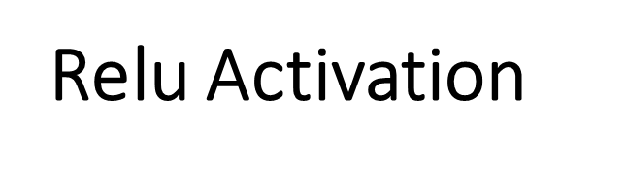
With the gradient equal to zero, during back propagation all the weights will not be updated, to fix this, we use Leaky ReLU. Also, ReLU functions are not zero-centered.
This means that for it to get to its optimal point, it will have to use a zig-zag path which may be longer.
Other functions such as tanh or the sigmoid function can be used to add non-linearity to the network, but ReLU generally works better in practice.
A "rectified feature map" is just a feature map that was created using Relu.

Slide 48
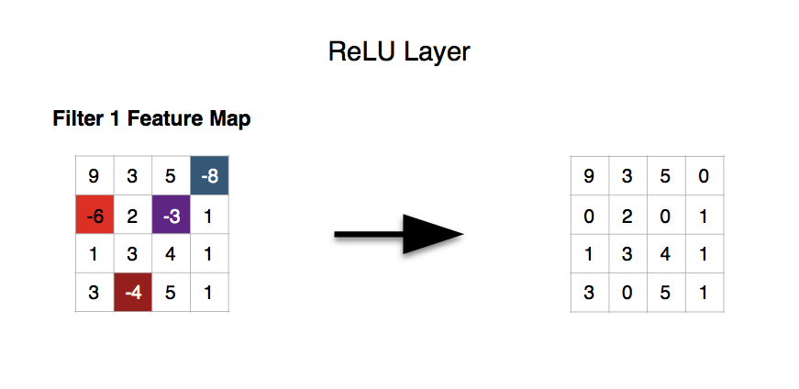
The ReLU (short for rectified linear units) layer commonly follows the convolution layer.
The addition of the ReLU layer allows the neural network to account for non-linear relationships, i.e. the ReLU layer allows the convnet to account for situations in which the relationship between the pixel value inputs and the convnet output is not linear. Note that the convolution operation is a linear one.

Slide 49
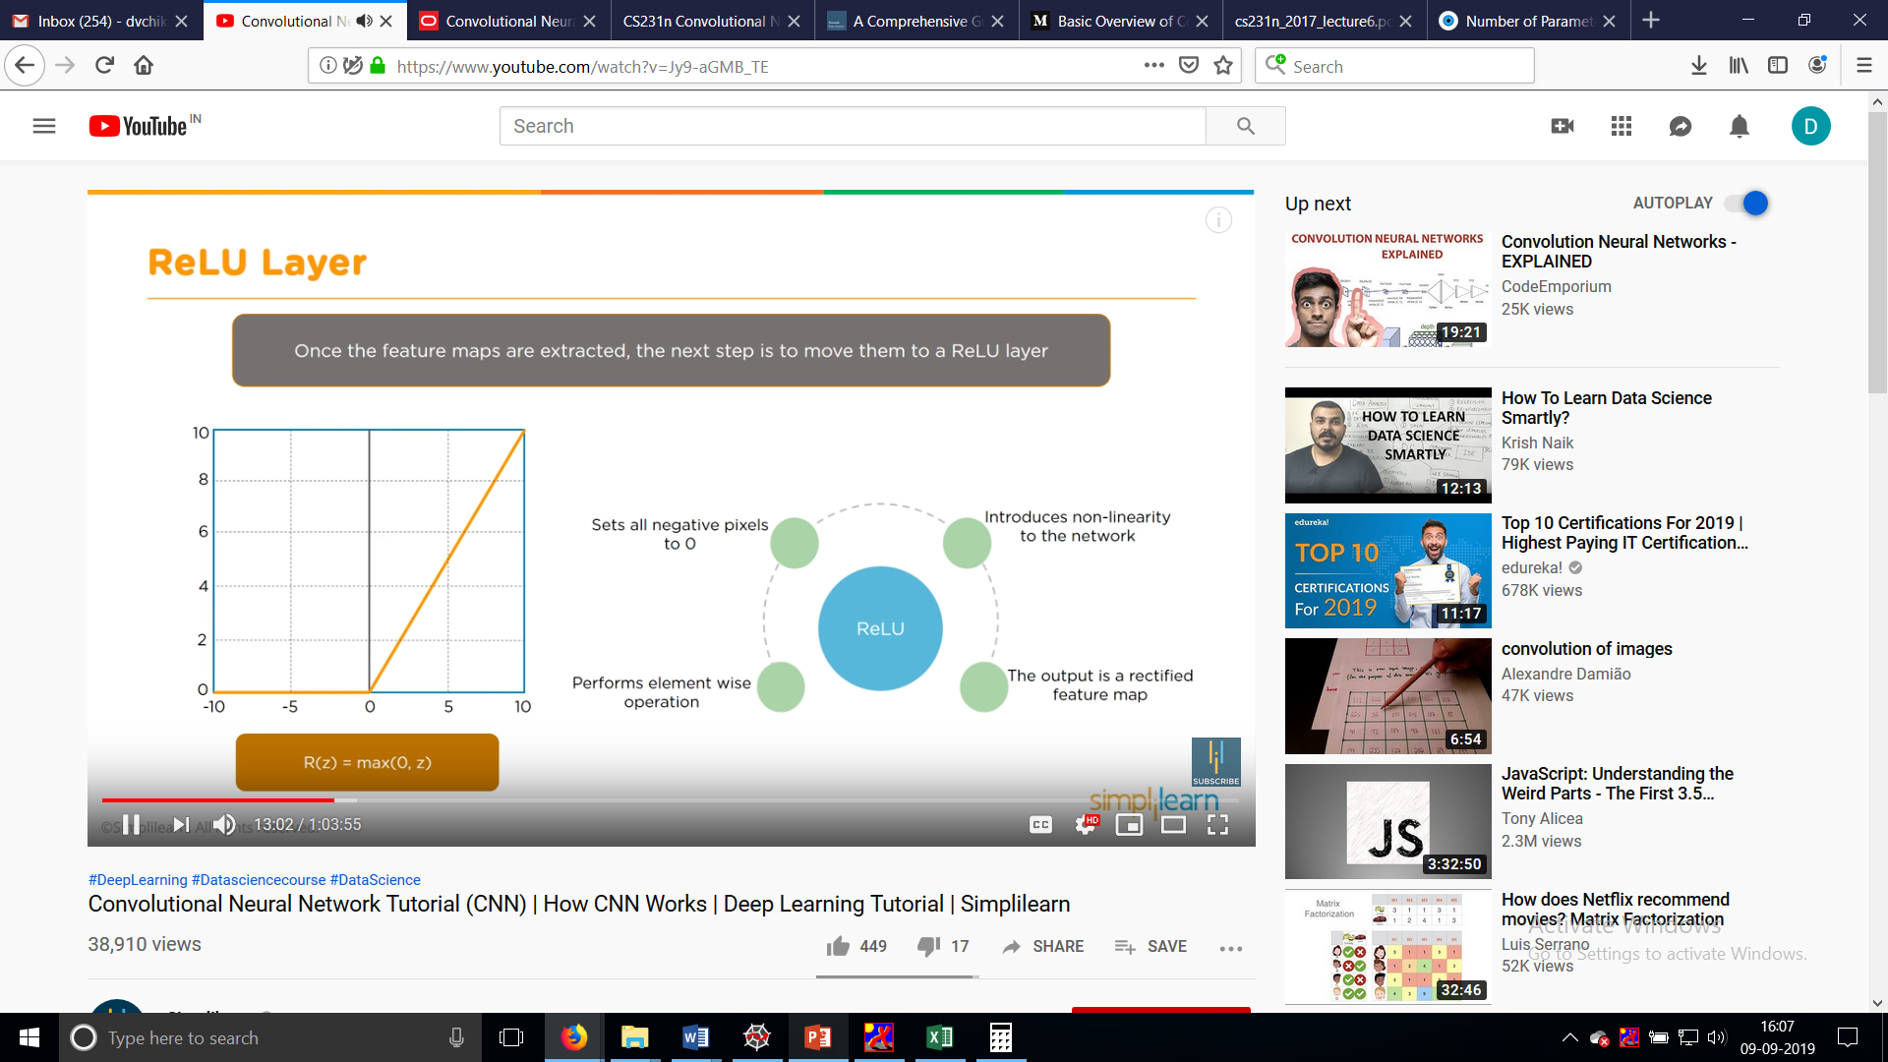

Slide 50
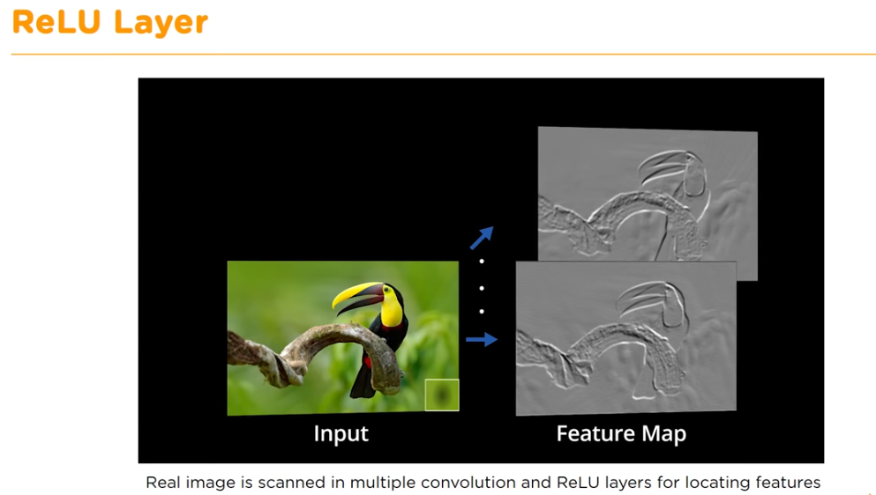

Slide 51
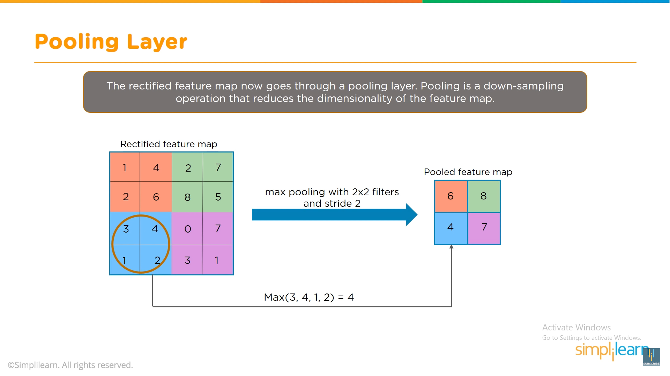
Pooling Layer

Slide 52
Max Pooling/Downsampling with CNNs
The next layer in a convolutional network has three names: max pooling, downsampling and subsampling.
The activation maps are fed into a downsampling layer, and like convolutions, this method is applied one patch at a time.
In this case, max pooling simply takes the largest value from one patch of an image, places it in a new matrix next to the max values from other patches, and discards the rest of the information contained in the activation maps.

Slide 53
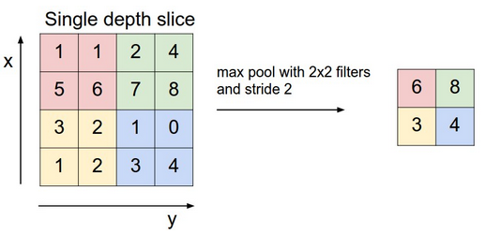

Slide 54
Pooling
There are two types of pooling:
1) Max Pooling
2) Average Pooling
The main purpose of a pooling layer is to reduce the number of parameters of the input tensor and thus
- Helps reduce overfitting
- Extract representative features from the input tensor
- Reduces computation and thus aids efficiency
The input to the Pooling layer is tensor(Rectified feature Map)
In case of Max Pooling, a kernel of size n*n (2x2 in the above example) is moved across the matrix and for each position the max value is taken and put in the corresponding position of the output matrix.
In case of Average Pooling, a kernel of size n*n is moved across the matrix and for each position the average is taken of all the values and put in the corresponding position of the output matrix.
So, a thing to note is, Pooling downsamples the image in its height and width but the number of channels(depth) stays the same.

Slide 55
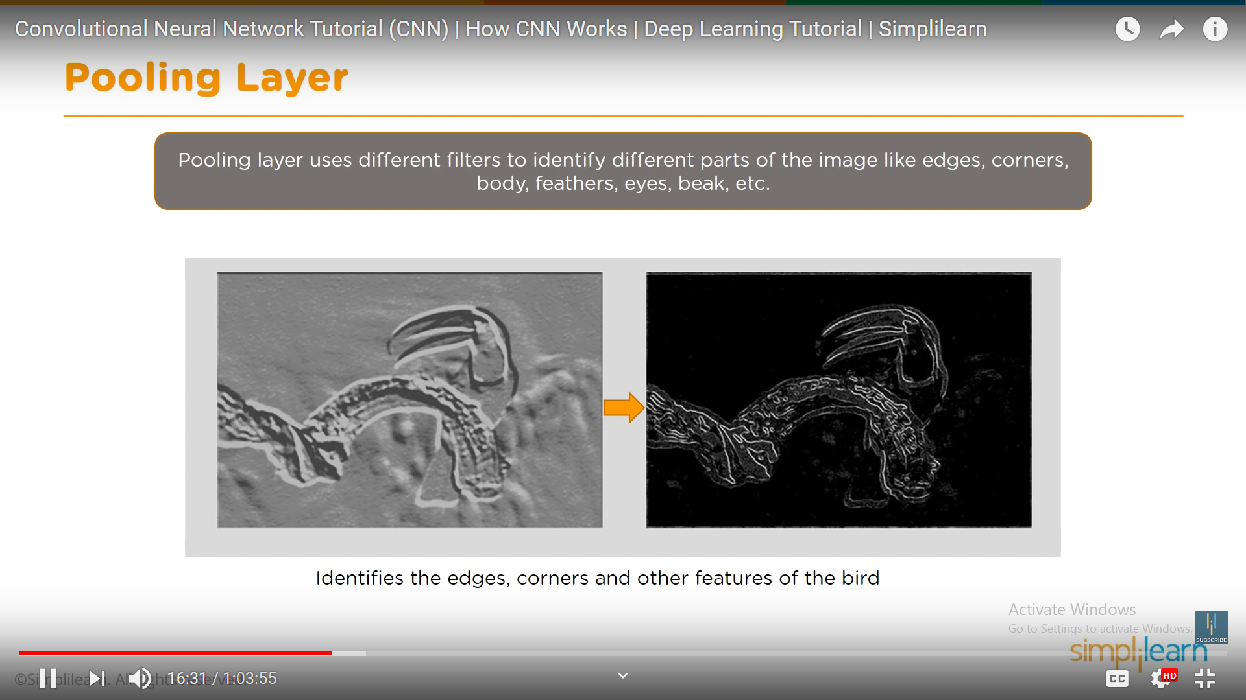

Slide 56
The function of Pooling
The function of Pooling is to progressively reduce the spatial size of the input representation .
In particular, pooling makes the input representations (feature dimension) smaller and more manageable reduces the number of parameters and computations in the network, therefore, controlling overfitting makes the network invariant to small transformations, distortions and translations in the input image (a small distortion in input will not change the output of Pooling – since we take the maximum / average value in a local neighborhood).

Slide 57
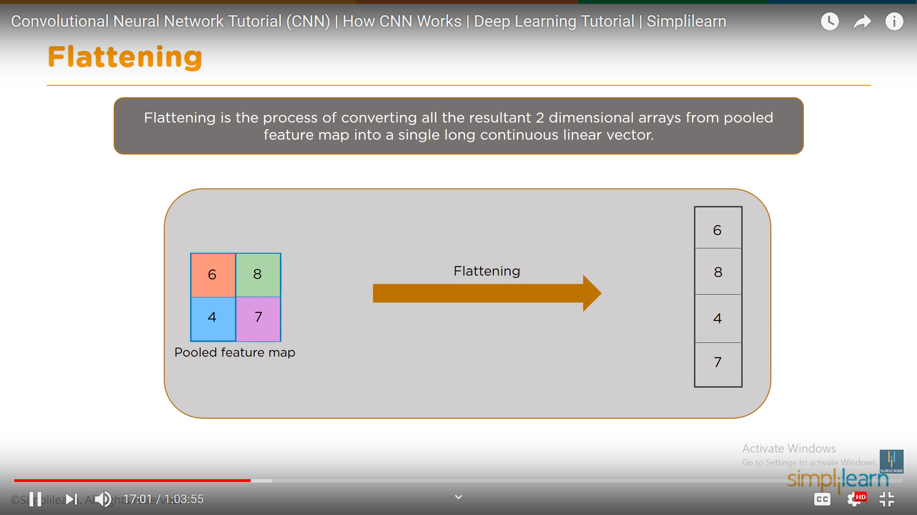

Slide 58
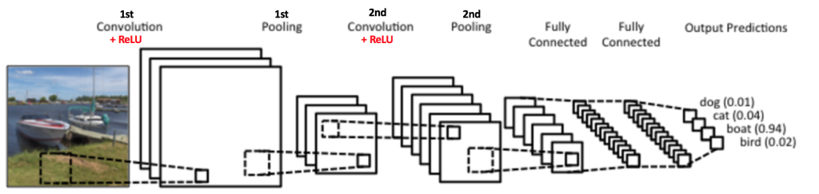
Overall Convolution, ReLU and Pooling work.

Slide 59
Overall Convolution, ReLU and Pooling work.
So far we have seen how Convolution, ReLU and Pooling work.
It is important to understand that these layers are the basic building blocks of any CNN.
As shown in Figure of previous slide, we have two sets of Convolution, ReLU & Pooling layers – the 2nd Convolution layer performs convolution on the output of the first Pooling Layer using six filters to produce a total of six feature maps. ReLU is then applied individually on all of these six feature maps.
We then perform Max Pooling operation separately on each of the six rectified feature maps.
Together these layers extract the useful features from the images, introduce non-linearity in our network and reduce feature dimension while aiming to make the features somewhat equivariant to scale and translation.
The output of the 2nd Pooling Layer acts as an input to the Fully Connected Layer, which we will discuss in the next section.

Slide 61
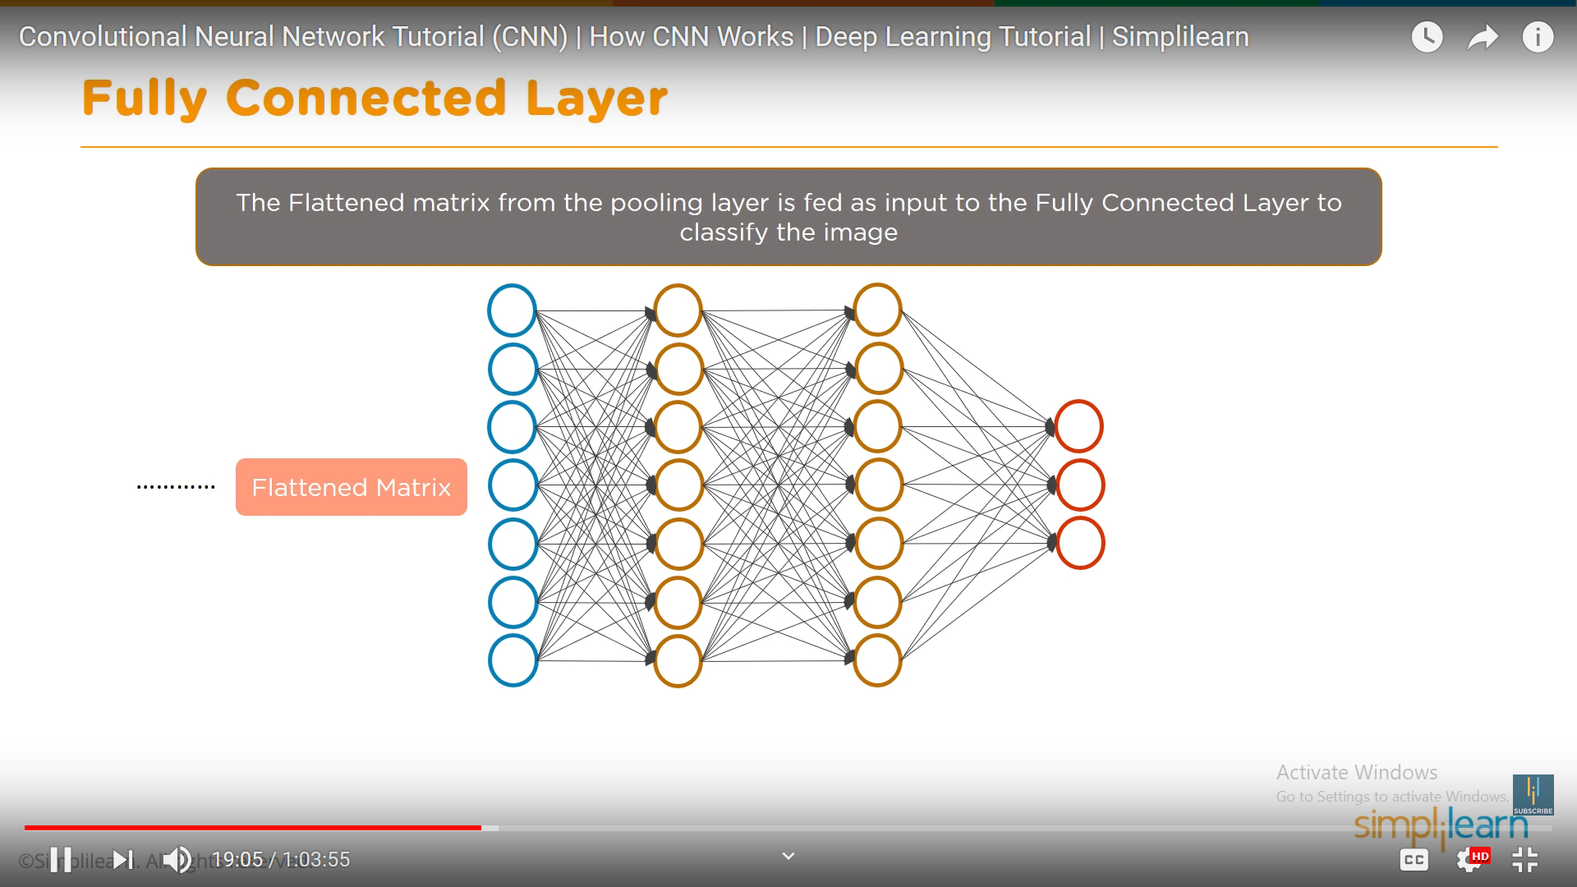

Slide 62
Fully connected Layer
This Flattened vector is then connected to a few fully connected layers which are same as Artificial Neural Networks and perform the same mathematical operations!
For each layer of the Artificial Neural Network, the following calculation takes place
G(Wx+B)
ANN Calculation for each layer

Slide 63
Fully Connected Layer
The Fully Connected layer is a traditional Multi Layer Perceptron that uses a softmax activation function in the output layer.
The term “Fully Connected” implies that every neuron in the previous layer is connected to every neuron on the next layer.
The output from the convolutional and pooling layers represent high-level features of the input image.
The purpose of the Fully Connected layer is to use these features for classifying the input image into various classes based on the training dataset.
For example, the image classification task we set out to perform has four possible outputs as shown in Figure below

Slide 64
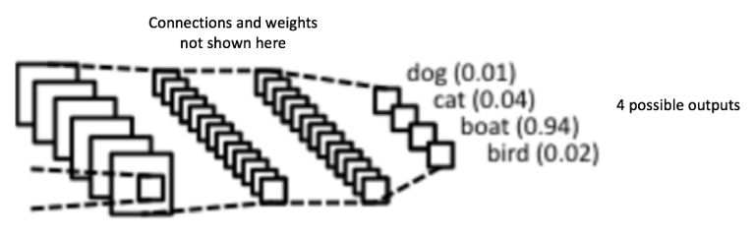
Figure 14: Fully Connected Layer -each node is connected to every other node in the adjacent layer
The sum of output probabilities from the Fully Connected Layer is 1.
This is ensured by using the Softmax as the activation function in the output layer of the Fully Connected Layer.
The Softmax function takes a vector of arbitrary real-valued scores and squashes it to a vector of values between zero and one that sum to one.

Slide 65
Softmax function
In classification tasks, we generally use a Softmax function as the Activation Function in the Output layer of the Multi Layer Perceptron to ensure that the outputs are probabilities and they add up to 1. The Softmax function takes a vector of arbitrary real-valued scores and squashes it to a vector of values between zero and one that sum to one. So, in this case,
Probability (Pass) + Probability (Fail) = 1

Slide 66
Case Study-Putting it all together – Training using Backpropagation
As discussed above, the Convolution + Pooling layers act as Feature Extractors from the input image while Fully Connected layer acts as a classifier.
Note that in Figure 15 below, since the input image is a boat, the target probability is 1 for Boat class and 0 for other three classes, i.e.
Input Image = Boat
Target Vector = [0, 0, 1, 0]

Slide 67
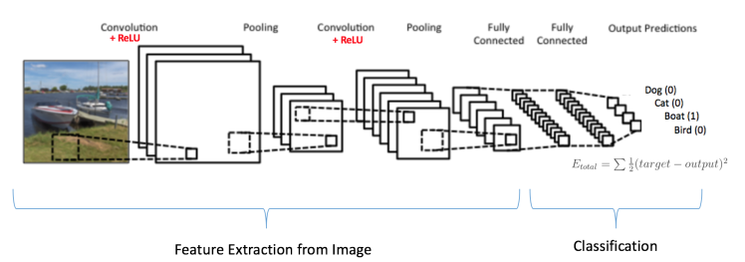
Case Study-Putting it all together – Training using Backpropagation
Figure 15: Training the ConvNet
https://ujjwalkarn.me/2016/08/11/intuitive-explanation-convnets/

Slide 68
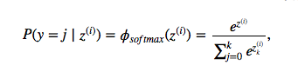
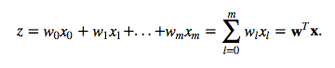
Softmax
As the name suggests, in softmax classification we replace the sigmoid logistic function by the so-called softmax function φ:
where we define the net input z as

Slide 69
(w is the weight vector, x is the feature vector of 1 training sample, and w₀ is the bias unit.) Now, this softmax function computes the probability that this training sample x^{(i)} belongs to class j given the weight and net input z^{(i)}. So, we compute the probability p(y = j | x^{(i)}; w_{j}) for each class label in j = 1, …, k. Note the normalization term in the denominator which causes these class probabilities to sum up to one.
To illustrate the concept of softmax, let us walk through a concrete example. Let’s assume we have a training set consisting of 4 samples from 3 different classes (0, 1, and 2)

Slide 70
Case Study-Putting it all together – Training using Backpropagation
The overall training process of the Convolution Network may be summarized as below:
Step1: We initialize all filters and parameters / weights with random values
Step2: The network takes a training image as input, goes through the forward propagation step (convolution, ReLU and pooling operations along with forward propagation in the Fully Connected layer) and finds the output probabilities for each class.
Lets say the output probabilities for the boat image above are [0.2, 0.4, 0.1, 0.3]
Since weights are randomly assigned for the first training example, output probabilities are also random.
Step3: Calculate the total error at the output layer (summation over all 4 classes)
Total Error = ∑ ½ (target probability – output probability) ²

Slide 71
Case Study-Putting it all together – Training using Backpropagation
Step4: Use Backpropagation to calculate the gradients of the error with respect to all weights in the network and use gradient descent to update all filter values / weights and parameter values to minimize the output error.
The weights are adjusted in proportion to their contribution to the total error.
When the same image is input again, output probabilities might now be [0.1, 0.1, 0.7, 0.1], which is closer to the target vector [0, 0, 1, 0].
This means that the network has learnt to classify this particular image correctly by adjusting its weights / filters such that the output error is reduced.
Parameters like number of filters, filter sizes, architecture of the network etc. have all been fixed before Step 1 and do not change during training process – only the values of the filter matrix and connection weights get updated.
Step5: Repeat steps 2-4 with all images in the training set.
The above steps train the ConvNet – this essentially means that all the weights and parameters of the ConvNet have now been optimized to correctly classify images from the training set.

Slide 72
Case Study-Putting it all together – Testing
When a new (unseen) image is input into the ConvNet, the network would go through the forward propagation step and output a probability for each class (for a new image, the output probabilities are calculated using the weights which have been optimized to correctly classify all the previous training examples).
If our training set is large enough, the network will (hopefully) generalize well to new images and classify them into correct categories.

Slide 73
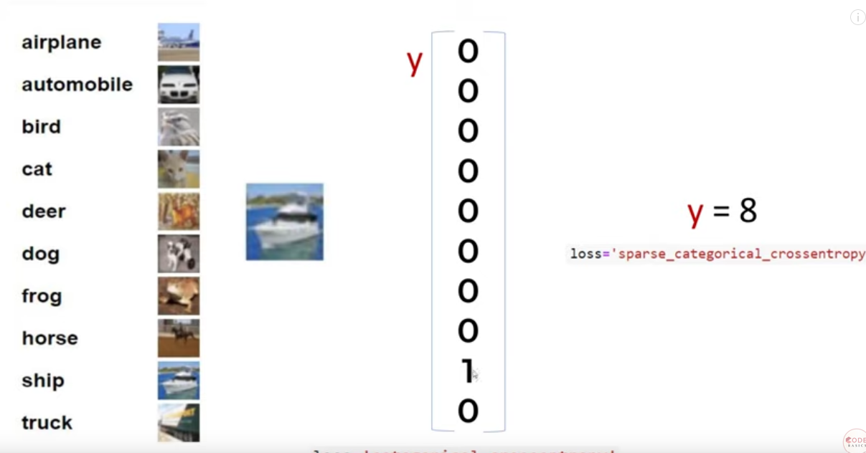

Slide 74
Visualizing Convolutional Neural Networks
Adam Harley created amazing visualizations of a Convolutional Neural Network trained on the MNIST Database of handwritten digits .
We will see below how the network works for an input ‘8’. Note that the visualization in Figure 18 does not show the ReLU operation separately.

Slide 75
Visualizing Convolutional Neural Networks
The input image contains 1024 pixels (32 x 32 image) and the first Convolution layer (Convolution Layer 1) is formed by convolution of six unique 5 × 5 (stride 1) filters with the input image.
As seen, using six different filters produces a feature map of depth six.
Convolutional Layer 1 is followed by Pooling Layer 1 that does 2 × 2 max pooling (with stride 2) separately over the six feature maps in Convolution Layer 1.
You can move your mouse pointer over any pixel in the Pooling Layer and observe the 2 x 2 grid it forms in the previous Convolution Layer (demonstrated in Figure 19).
You’ll notice that the pixel having the maximum value (the brightest one) in the 2 x 2 grid makes it to the Pooling layer.

Slide 76
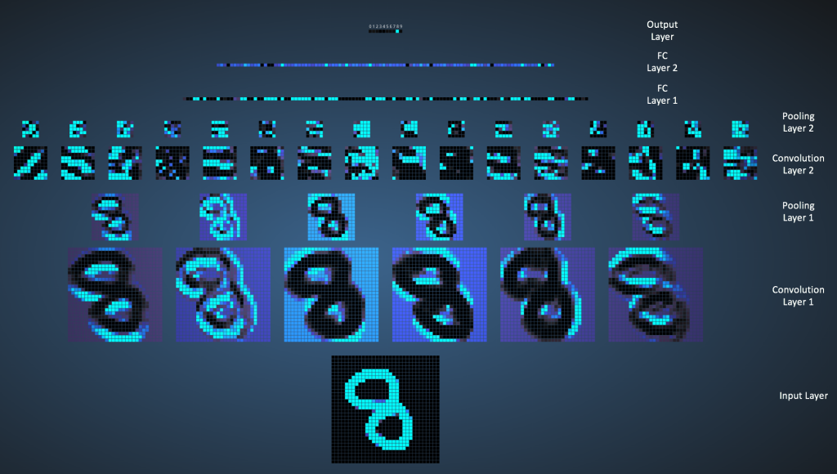

Slide 77
Pooling Layer 1 is followed by sixteen 5 × 5 (stride 1) convolutional filters that perform the convolution operation. This is followed by Pooling Layer 2 that does 2 × 2 max pooling (with stride 2). These two layers use the same concepts as described above.
We then have three fully-connected (FC) layers. There are:
120 neurons in the first FC layer
100 neurons in the second FC layer
10 neurons in the third FC layer corresponding to the 10 digits – also called the Output layer
Notice how in Figure 20, each of the 10 nodes in the output layer are connected to all 100 nodes in the 2nd Fully Connected layer (hence the name Fully Connected).
Also, note how the only bright node in the Output Layer corresponds to ‘8’ – this means that the network correctly classifies our handwritten digit (brighter node denotes that the output from it is higher, i.e. 8 has the highest probability among all other digits).

Slide 78
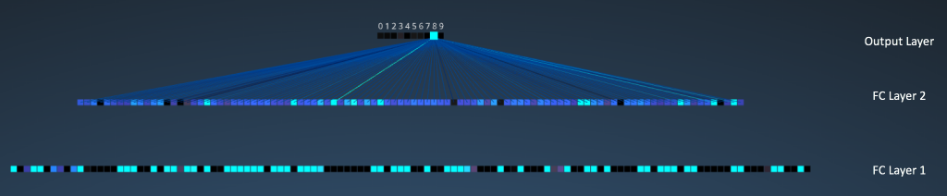
Figure 20: Visualizing the Filly Connected Layers. Source

